Slide 1
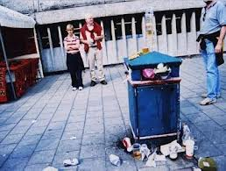
LO: Debating. 4.10.2013 Hristyana
Reasons why:
Pot your rubish
ni the bin because it mke people sick.
Reasons why:
I wont to put the litter in room 101 .
Because it is bad
for our world.
Reasons why:
Wene the litter is not potn in the bin it maks awer word messy.
Reasons why:
Pot your rubish
In the bin because they can als hurt animals.

