Slide 1
Starters
Today’s estimation.
http://www.estimation180.com/day-31.html
Use Hit the Button to practise times tables and division skills.
https://www.topmarks.co.uk/maths-games/hit-the-button

Slide 2
Problems of the day

Slide 3
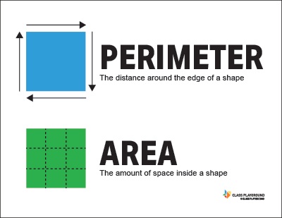
What is perimeter?

Slide 4
Play the video below. You will certainly have the song playing in your head all day long. And it’s by Adam Up!
https://www.youtube.com/watch?v=n5ULJ_kcFzI

Slide 5
Try these yourself – remember the opposite sides of a square or a rectangle are the same.

Slide 6
Answers

Slide 7
Try this link for questions on the perimeter of a triangle.
https://www.mathexpression.com/triangle-practice-3.html

Slide 8
This video can help you if you are still not sure
https://www.khanacademy.org/math/basic-geo/basic-geo-area-and-perimeter/basic-geo-perimeter/v/introduction-to-perimeter

Slide 9
Extension perimeter work

Slide 10
Answers

