Slide 1
Starters
Today’s estimation.
http://www.estimation180.com/day-42.html
Use Hit the Button to practise times tables and division skills.
https://www.topmarks.co.uk/maths-games/hit-the-button

Slide 2
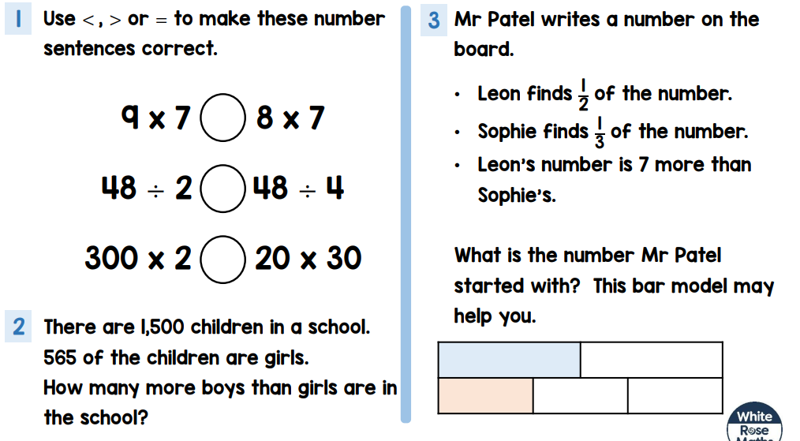
Problems of the day

Slide 3
Answers to Problems of the Day
<
>
=
2 – 370 more boys than girls
3 – Mr Patel started with the number 42 (21 x 2 =42 and 14 x 3 = 42)

Slide 4
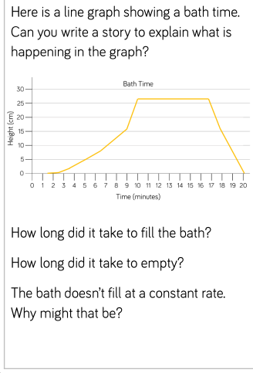
Challenge 1

Slide 5
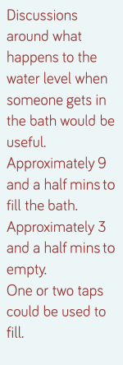
Challenge answers

Slide 6
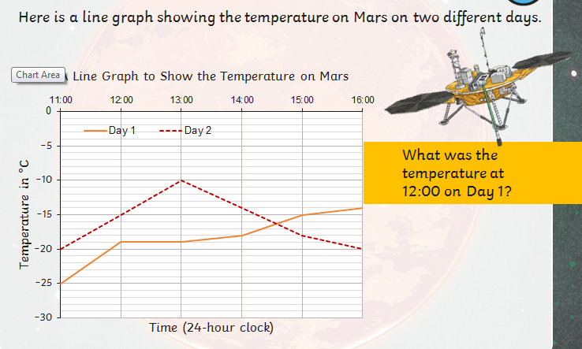
Challenge 2

Slide 7
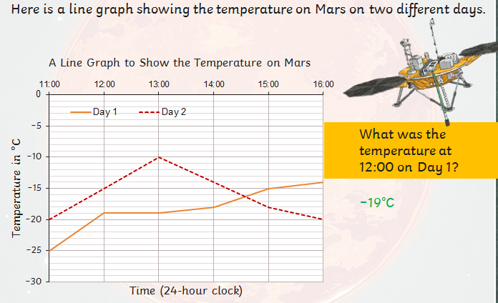

Slide 8
Challenge 3

Slide 9
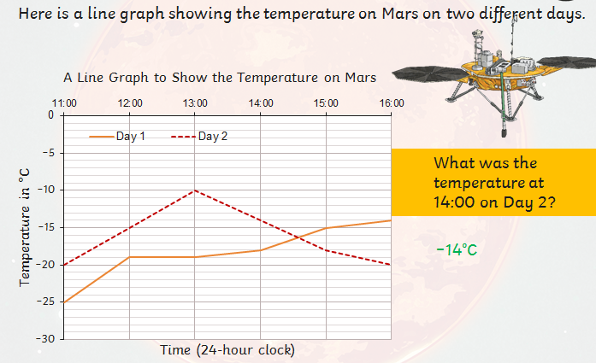

Slide 10
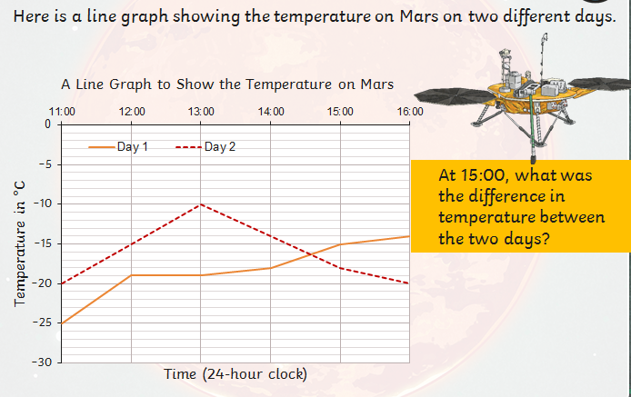
Challenge 4

Slide 12
Challenge 5

