Slide 1
Describe your vehicle
from the future!
The children designed a vehicle from the future and recorded their descriptions of these vehicles.
Click on the sound icon to hear their recordings.

Slide 2
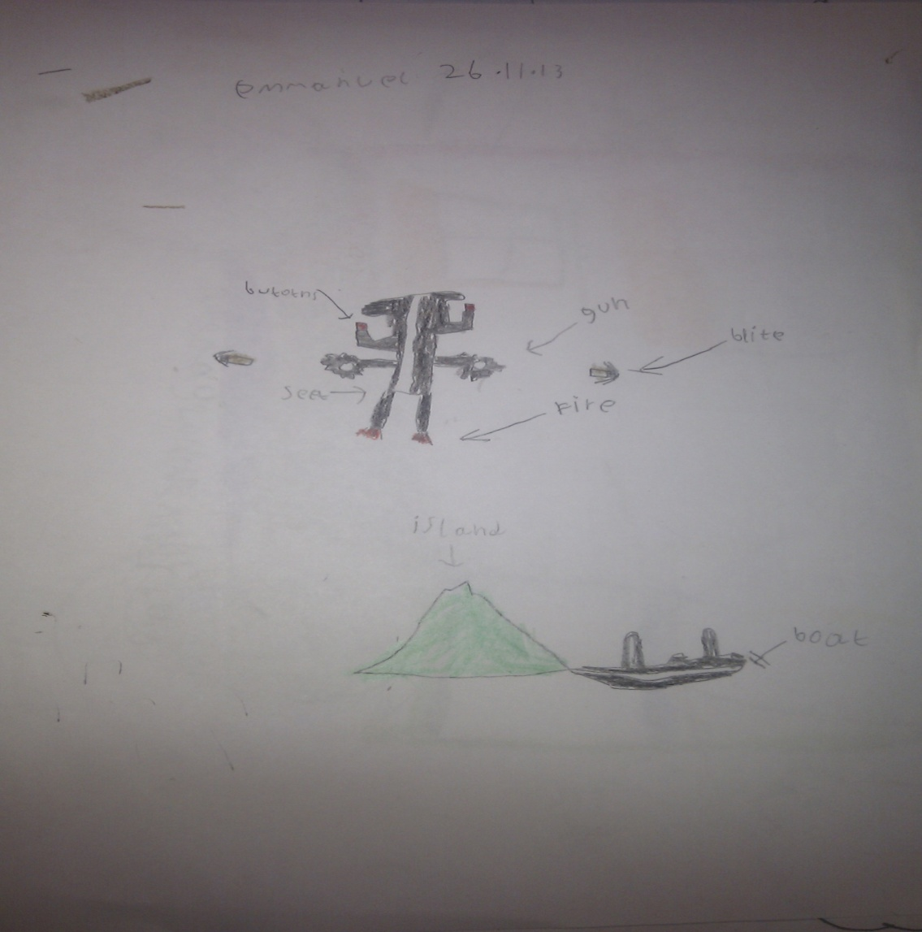
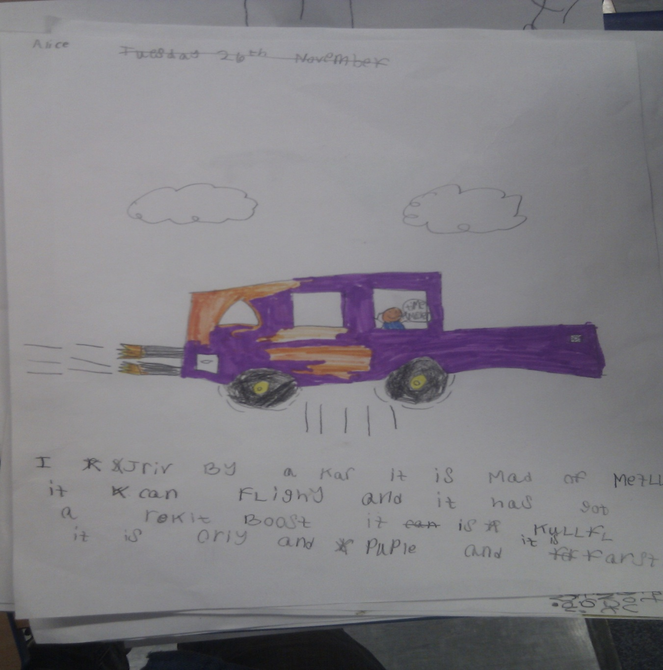
Emmanuel:
PRESS ME!
PRESS ME!
Alice:

Slide 3
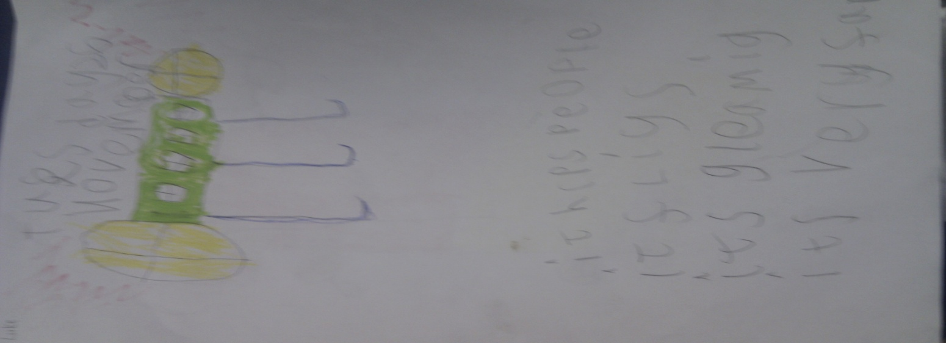
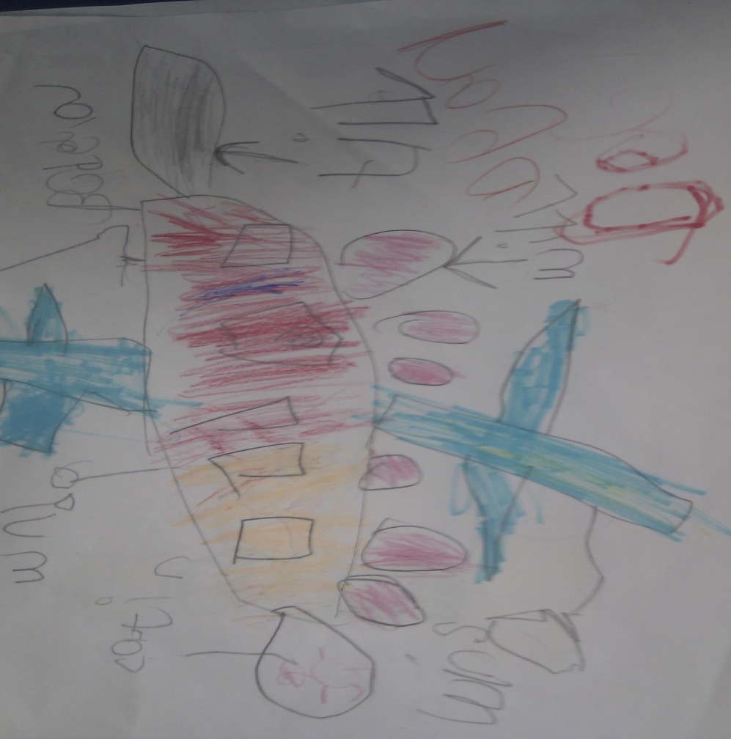
Luke:
Dean:
PRESS ME!

Slide 4
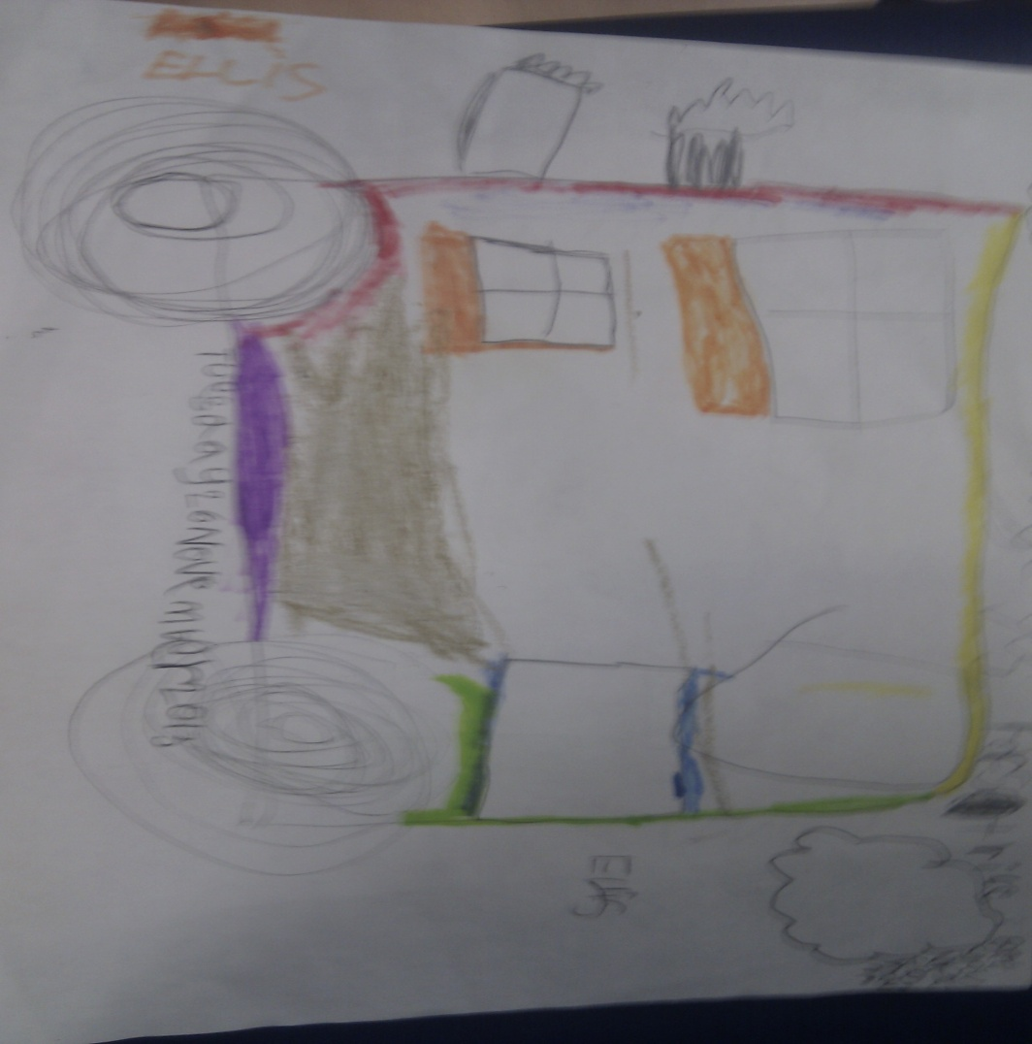
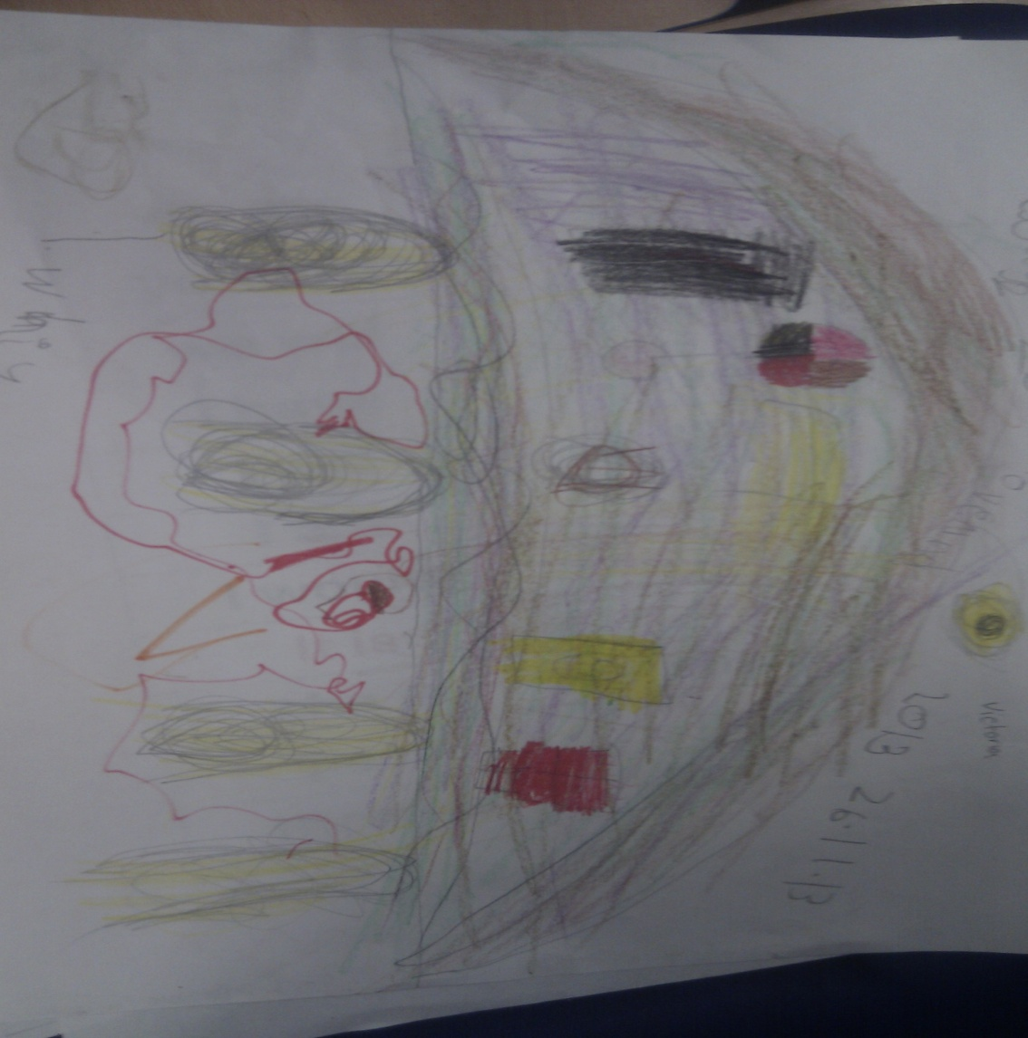
PRESS ME!
Victoria:
Ellis:
PRESS ME!

Slide 5
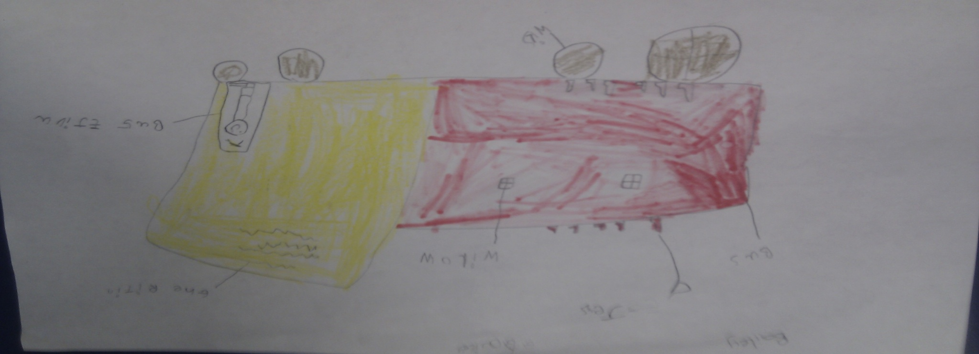
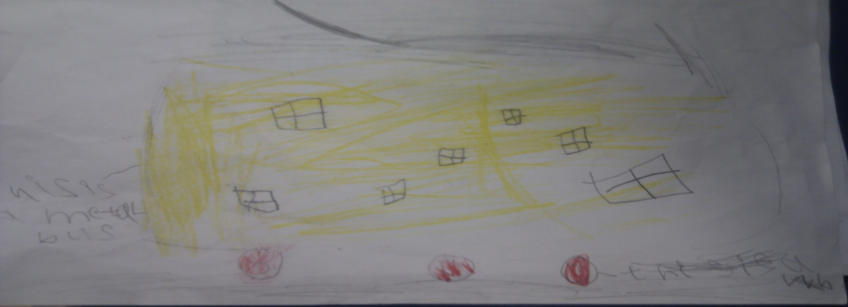
Bailey:
PRESS ME!
James:

