Slide 1
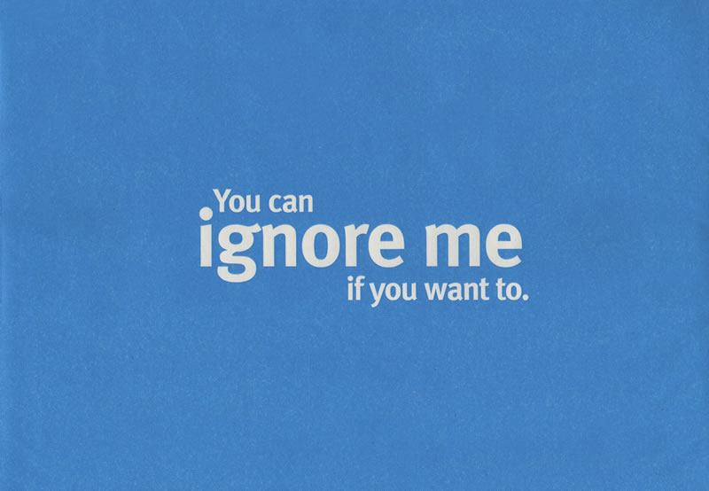
Water Aid
By Ruby & Kitty

Slide 2
introduction
Were going to tell you about a country called Swaziland a place on the edge of south Africa probably a place you haven't even heard of .

Slide 3
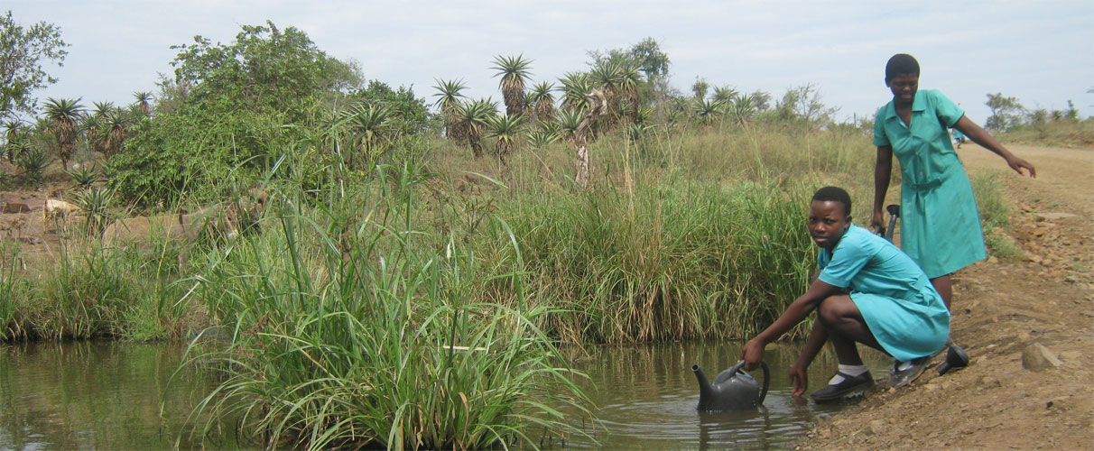
What is the issue?
280K
people in Swaziland don't have access to safe water. This is nearly a third of the population.
0.43M
430,000 people don't have access to adequate sanitation in Swaziland, over two fifths of the population.
160
Over 160 children die every year from diarrhoea caused by unsafe water and poor sanitation in Swaziland.
The country has the world's highest proportion of people with living HIV/AIDS – one in four adults. These people are more vulnerable to diarrhoeal diseases and need safe water for medication to be effective.

Slide 4
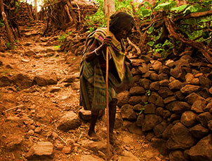
This is how much we helped last year
This is how much they helped last year •1,000 people with safe water
•1,000 people with improved sanitation.!
But this is just some help, there is still many with the bare minimum to survive.

Slide 5
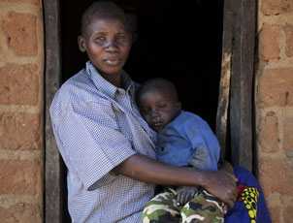
What water aid does?
Gives clean sanitation to the villages who need it .
Produces water pumps and fountains .
They train people to install pumps them selves

Slide 6
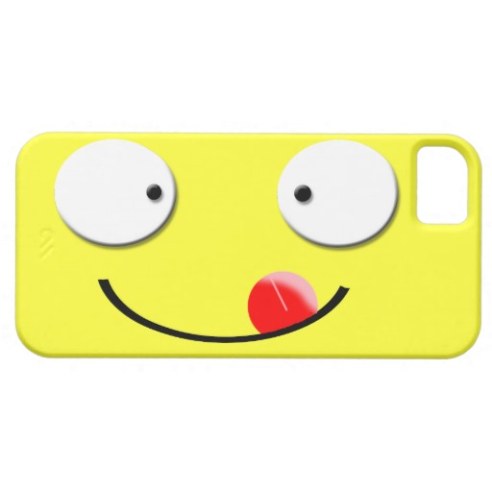
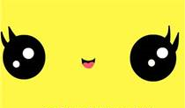
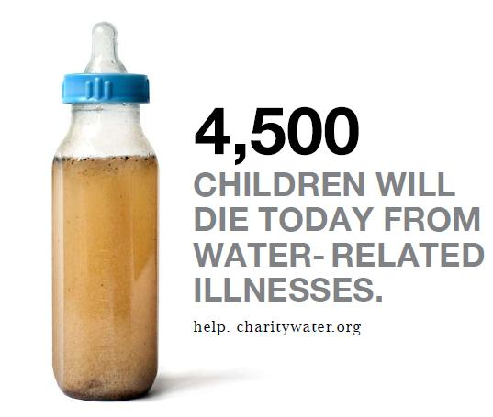
!thanks for watching!

