Slide 1
Madagascar and Kenya facts
By Jude Mansoor - Lloyd

Slide 2
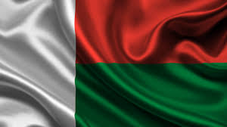
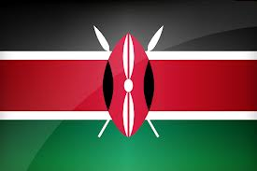
What is the issue?
In Kenya 16 million people don’t have access to safe water.
Over 29 million people in Kenya don’t have access to adequate sanitation.
Nearly 11 million people have no access to clean and safe water in Madagascar. The effects are huge!
Over 18 million people in Madagascar don’t have access to adequate sanitation.
Over 4000 children die every year die from diarrhoea caused by unsafe water and poor sanitation

Slide 3
Who is affected?
In the WHOLE of Africa the lack of water is lethal, fatal and serious. This can cause diarrhoea and internal organ breakdown! Every age, children, teenagers and the adults.
This clearly means we all from around the world should be helping more to these poor people survive and have a decent life!

Slide 4
How serious is the problem?
This problem is extremely serious as 1/7th of the world is dying from inadequate sanitation and unsafe water!!!
The approximate statistic from all of this is 7 out of 10 people.

Slide 5
What is already being done?
At the moment the what is being done to prevent this from happening is Water aid and many other organizers are installing pumps and wells to collect water and also schools in England are toilet twinning with places in Africa such as Madagascar and Kenya. Also water aid is constructing new and fresh toilets so people can do their business properly. And they are building normal houses than the slums that Africa have at the moment.

Slide 6
What could we do differently?
What we could do differently is that we could send some people over to where the water is unsafe water and there is inadequate sanitation so that they can learn how the terrain is and learn more facts.

Slide 7
!!!HOPE YOU ENJOYED!!!

