Slide 1
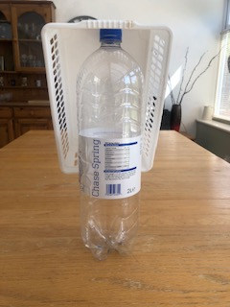
Primary at home challenges
KS2
GAME 6: Equipment needed: 1 plastic basket, 1 empty large plastic bottle
and a ball or pair of rolled up socks. It can be set up outside or on a table.
BASKET TRAP
1. Turn the basket upside down and place on top of the bottle as in the
picture right.
2. Using your ball or rolled up socks try to hit the bottle so that the basket
drops to the floor on its back and the bottle lands inside it. The bottle must
land inside the basket.
3. Playing with a partner? Who can knock the mousetrap down first?
4. Make it harder by moving it further away each time you are successful.
5. Try balancing the basket on different items such as a toilet roll.
Challenge all family members!
Make sure there is nothing breakable behind it!
Accuracy is important when aiming at a post or wickets in rounders or cricket!

