Slide 1
Week 1 Day 2 Home Learning
LO: Use adverbs in my writing

Slide 2
The Man Who Bought A Mountain
Task 1:
Read back through the short paragraph from the story – “The Man Who Bought a Mountain”.

Slide 3
LO: Use adverbs in my writing
Go back through your story from yesterday – highlight and list all of the verbs that you used.
How many can you find?
If you didn’t have many, is there any more that you could add into your story?

Slide 4
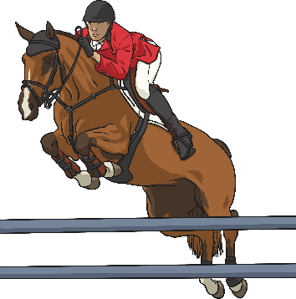
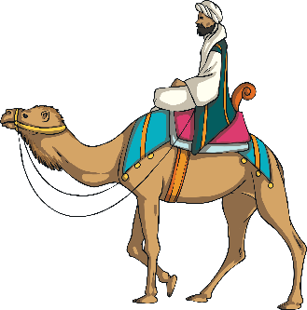
Task 2:
Look through “What is an Adverb” and add an adverb to the start of each of the verbs you have listed.
Write each adverb/verb combo into a sentence. You should have at least 6 sentences.
What is an Adverb?
An adverb is something that tells you where, why or how something is done. For example:
Camilla crossed the road safely.
Saffie’s horse bravely jumped over the hurdle.
The Moroccan man rode his camel everywhere.
Many adverbs end in –ly but not all of them. Similarly, not all words which end in –ly are adverbs.

Slide 5
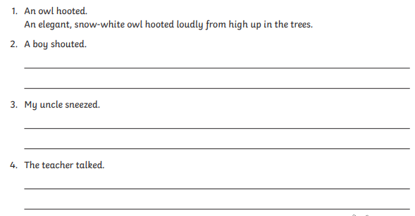
Extension

Slide 6
