Slide 1
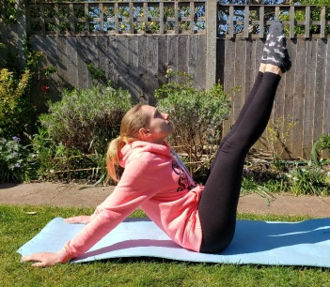
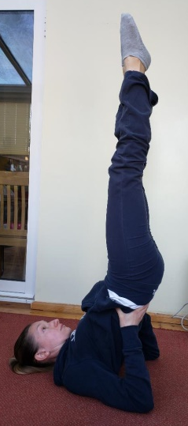
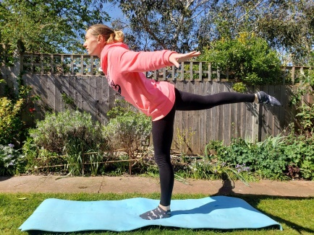
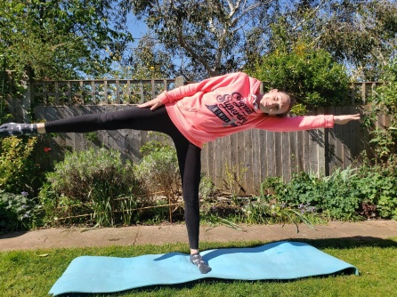
Primary at home challenges
KS2
Gym 3: Balances
Try each balance below holding them for 3 seconds each. Now try again, can you hold them for 5 seconds this time?
Can you think of any other balances?
GOOD LUCK!
Shoulder Stand
Frog Balance
Arabesque
Can you do an arabesque and the T balance on the other leg?
V-Sit (with or without hands)
T Balance
Can you challenge a family member?

