Slide 1
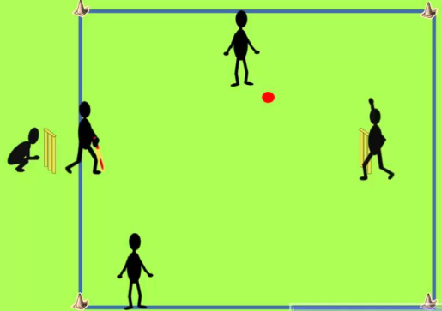
Primary at home challenges
KS2
GAME 5: You will need a bat or frying pan and a ball or rolled up socks. For a wicket you will also need a bucket, box or basket.
CRICKET OVER CHALLENGE
1. Set up a pitch in the space that you have as in the picture.
2. You can play with a minimum of 2 players [bowler and batter].
3. The batter stands with only the bat in front of the wicket, the
bowler stands opposite them and bowls 6 balls [an over] to them.
4. Bowling can be underarm or overarm depending on the space you have.
5. The batsman has to decide to run whether or not the ball
is hit. They can run more than once.
6. Running can be to the side marker and then back to the
wicket or forwards and backwards to the wicket [see diagram].
How many can you score by running off of 6 balls [an over]?
Challenge all family members. GOOD LUCK!
You can be out if you:
hit the wicket, get caught, bowled, run out or stumped!

