Slide 1
Starters
Today’s estimation.
http://www.estimation180.com/day-46.html
Use the boys height – you can click to remind you.
You can get 20 cm either side, I was 3cm away. Can you get closer!
Use Hit the Button to practise times tables and division skills.
https://www.topmarks.co.uk/maths-games/hit-the-button

Slide 2
Problems of the day

Slide 3
Answers to Problems of the Day

Slide 4
Today we are going to look at timetables. Before we begin, attempt the challenge below. How many can you think of?
Where do you see timetables?
Why are they useful?
I have written a list of 7 on the next slide. How many can you think of? Can you beat me?

Slide 5
Timetables
Bus stop
Train station
School
Cinema
University
Day trip
School residential

Slide 6
Some links to refresh your memory on telling the time
https://www.youtube.com/watch?v=UvcqVGEMGbY
https://www.youtube.com/watch?v=ENOYemdWU08
Now try these links to help with the 24 hour time.
https://www.bbc.co.uk/teach/class-clips-video/maths-ks2-using-timetables/zn2hy9q
https://www.youtube.com/watch?v=CzD_sdv2gIc - this is a longer video but has plenty of examples.

Slide 7
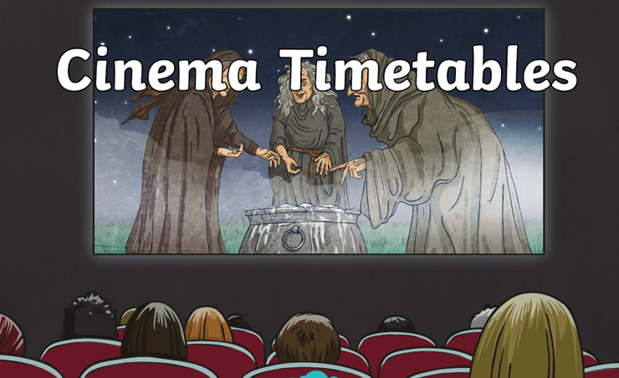
It is important to be able to tell the time when reading a timetable so have a try of the challenges coming up.

Slide 8
Challenge 1

Slide 9
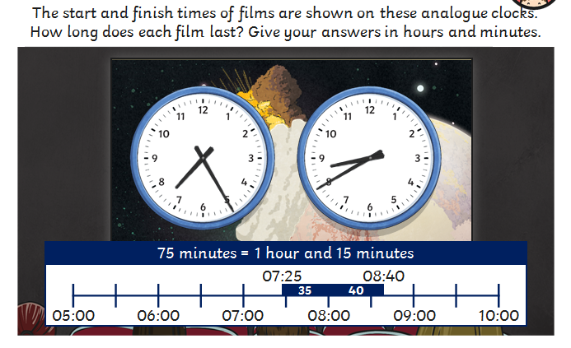
Answer

Slide 10
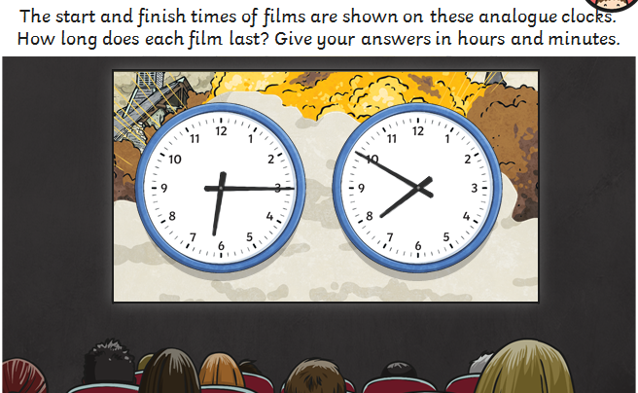
Challenge 2

Slide 11
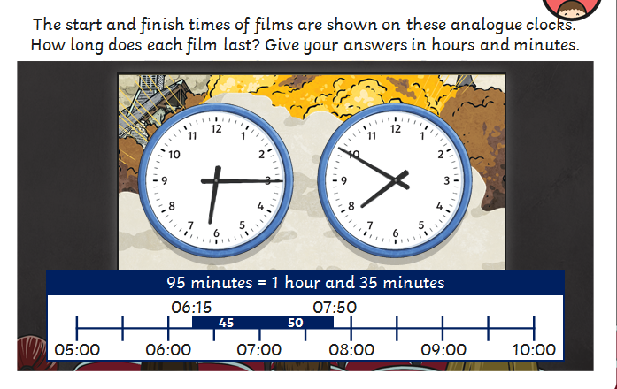
Answer

Slide 12
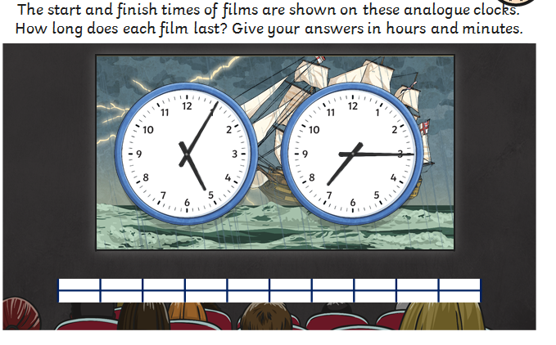
Challenge 3

Slide 13
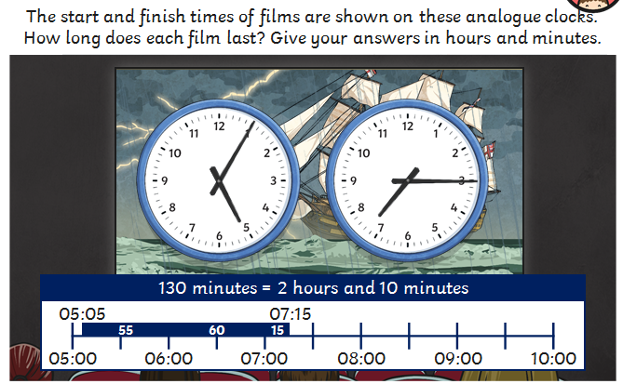
Answer

Slide 14
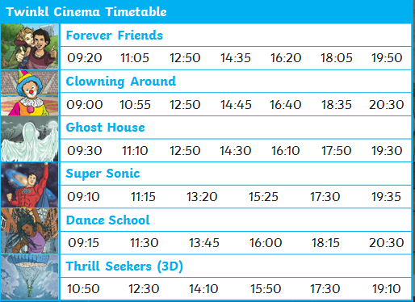
Use the cinema timetable to answer my questions.
1. If I get to the cinema at 09:15, which films have not started yet?
If I arrive at the cinema at 14:00, which film would be the first that I could watch?
Extension question:
If there is just a 15 minute cleaning time for each showing, can you work out how long each film lasts?

Slide 15
Use the cinema timetable to answer my questions.
1. Forever Friends, Ghost House and Thrill Seekers
Thrill Seekers (3D)
Extension question:
Forever Friends – 1 hour and 30 minutes
Clowning Around – 1 hour and 40 minutes
Ghost House – 1 hour and 25 minutes
Super Sonic – 1 hour and 50 minutes
Dance School – 2 hours
Thrill Seekers (3D) – 1 hour and 25 minutes

Slide 16
Plenary
Use this link to learn a little more about finding information from a timetable. It is similar to how we taught it earlier in the year.
https://www.youtube.com/watch?v=40BJ0o0VD-0

