Slide 1
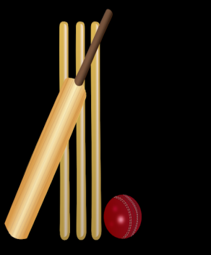
INSTRUCTIONS
WELCOME TO OUR CRICKET WEEK!
Choose your aspect of the game: fielding, throwing, bowling and batting.
Can you complete all 4 challenges within that aspect individually or with a partner?
Or you can start at Bronze challenges, then Silver and then progress to Gold or Platinum with practice and determination.

Slide 2
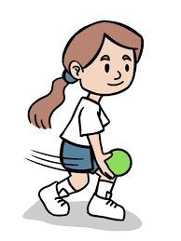
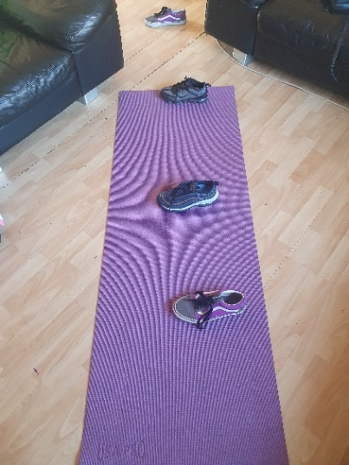
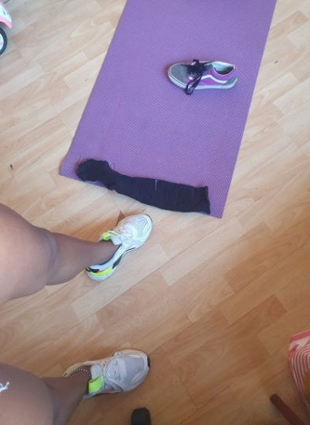
Cricket
Bronze Challenge: Throwing
You can do this sitting down too.
Space the targets further apart and have another try!
Place 4 targets in a line spaced apart on the floor.
Stand behind the line. Standing side on, one foot in front of the other.
Throw the ball/socks under arm aiming for the first target.
Can you hit the second target? Repeat for target three and four.
How many targets did you successfully hit?

Slide 3
Cricket
Silver Challenge: Throwing
Extra Challenge-
Can you throw, touch your head, shoulders, knees and toes then catch?
Use your preferred hand, throw and catch to your yourself?
Now try to throw clap then catch?
Repeat all using the opposite hand.
Throw and see how many claps you can do before catching the ball/socks.
1
4
2
Use a small ball or rolled up socks to throw and catch.
3

Slide 4
Cricket
Gold Challenge: Throwing
Lay out three small balls or rolled up socks in a straight line. Place a bucket on its side at one end and a marker at the other end.
Ask someone to time you.
Start next to the first ball. Run around the marker and back to the ball, pick the ball up and under arm throw the ball into the bucket.
Repeat the same with ball two and three.
How long did it take you?
How many did you get in the bucket?
Can you improve your score?
Can you challenge someone else?
Can you move the bucket further away?

Slide 5
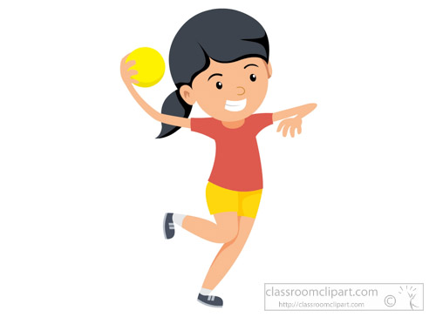
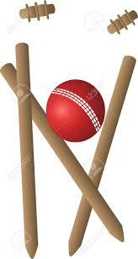
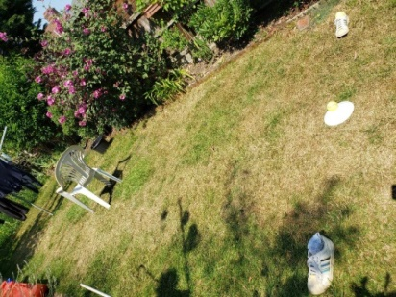
Cricket
Platinum Challenge: Throwing
Place three markers spaced apart in a line on the floor. Then set up stumps or a chair as a target.
Stand behind the markers, opposite foot to throwing arm in front.
Starting at the middle marker pick up the first ball/socks and throw overarm at the target.
Move sideways to the right marker and throw the ball at the target. Move to the left target and repeat.
Can you repeat the challenge using the opposite hand to throw?
How many balls successfully hit the target?
Can you improve your score?

