Slide 1
Starters
Today’s estimation.
http://www.estimation180.com/day-34.html
Use Hit the Button to practise times tables and division skills.
https://www.topmarks.co.uk/maths-games/hit-the-button

Slide 2
Problems of the day

Slide 3
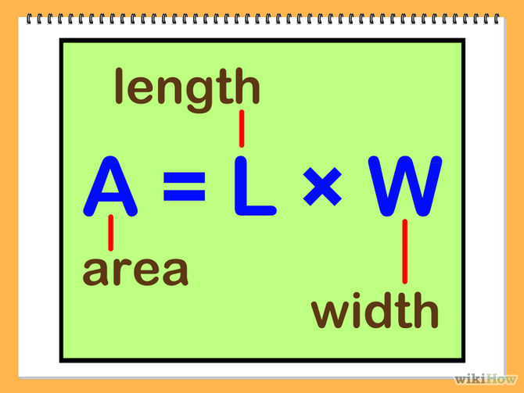
What formula do you use to find the area of a rectangle?

Slide 4
Explain your answer.

Slide 5
Example of an answer

Slide 6
Football pitch challenge,

Slide 7
Answers
Wembley - 7,245m²
Old Trafford – 7,140m²
Anfield – 6,868m²
White Hart Lane – 6,700m²

Slide 9
Example

Slide 10
Try this game to support your learning. Includes estimating!
http://www.scootle.edu.au/ec/viewing/L383/index.html#

Slide 11
Use this to practise.

Slide 12
Questions

Slide 13
Answers

Slide 14
Extension compound area work

Slide 15
Answers

