Slide 1
Lesson 2: Sentences To write interesting sentences which make sense to my reader
Success Criteria
Adjectives
Full stops
Sense
Capital letters

Slide 3
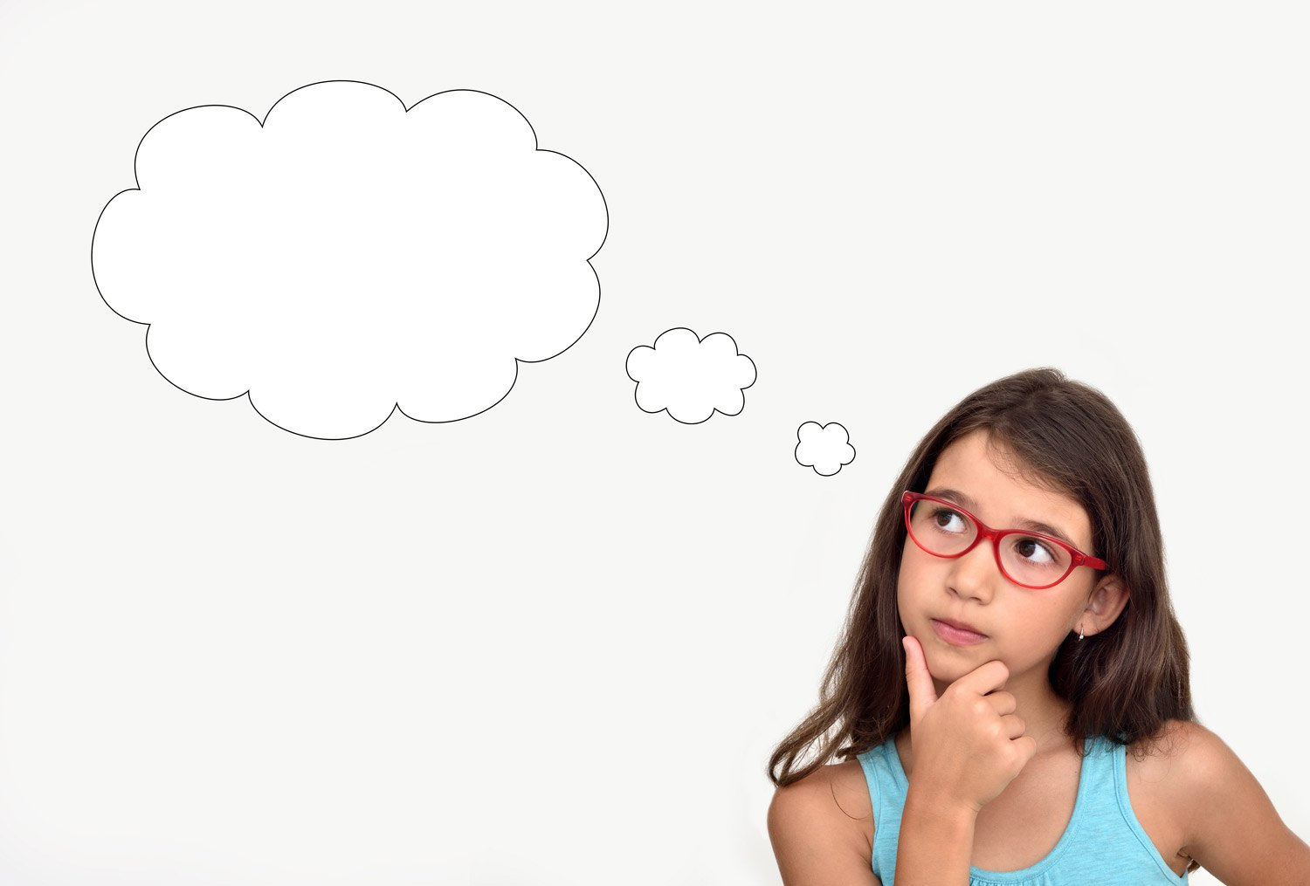
What is an adjective?

Slide 4
What is an adjective?
An adjective is a word used to describe.
e.g crooked, brown, colossal
Can you think of any others?

Slide 5
What is a verb?

Slide 6
What is a verb?
A verb is a doing word
e.g chattering, squawking, roaring
Can you think of any others?

Slide 7
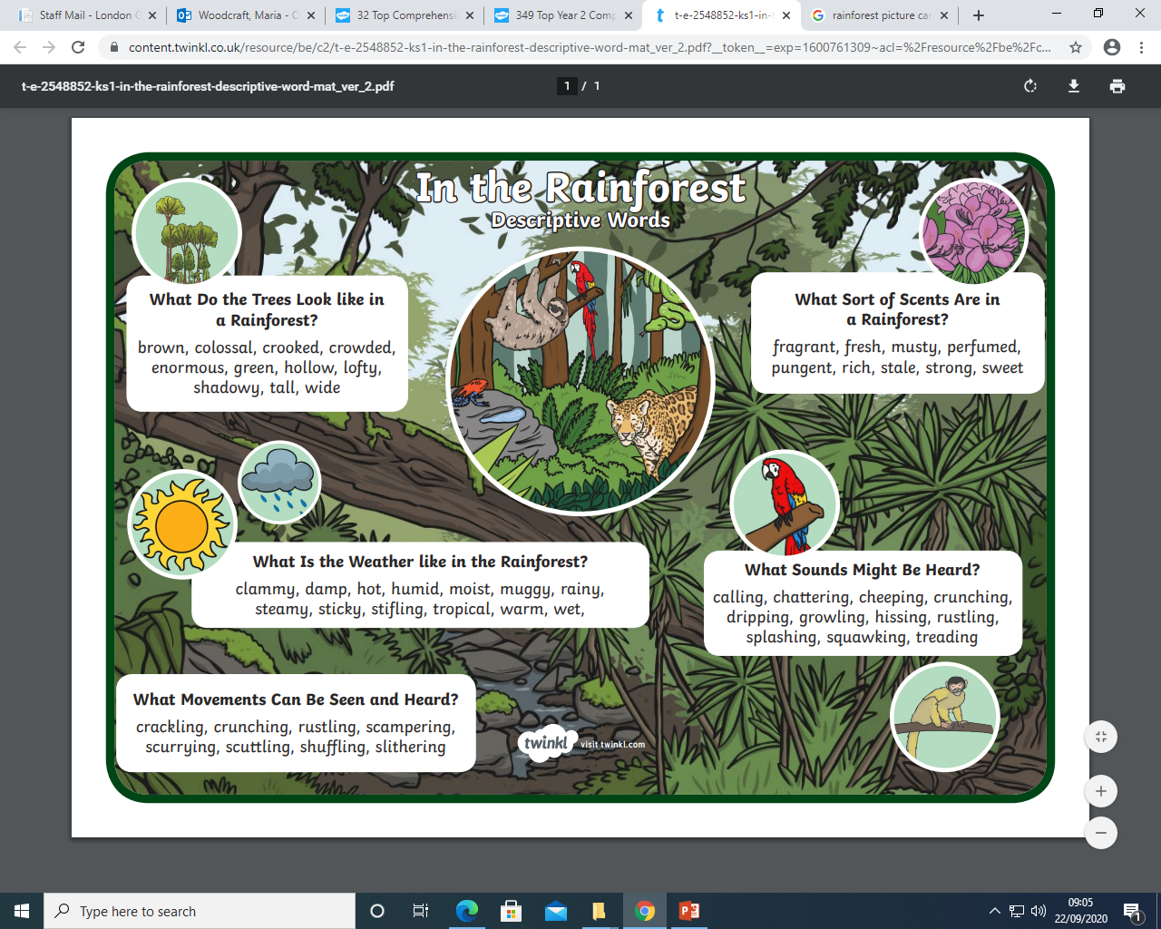

Slide 8
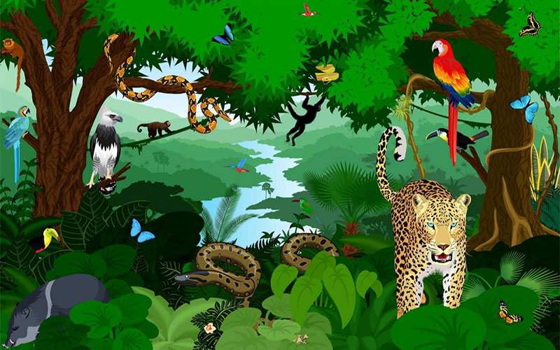
Write some sentences to describe this picture using the jungle word mat, full stops, and capital letters.

Slide 9
Read your sentence out loud. Does it make sense? Is it exciting? How have you used punctuation? How could you make it even better? What have you done very well? WELL DONE :)

