Slide 1
Starters
Today’s estimation.
http://www.estimation180.com/day-30.html
Use Hit the Button to practise times tables and division skills.
https://www.topmarks.co.uk/maths-games/hit-the-button

Slide 2
Problems of the day

Slide 3
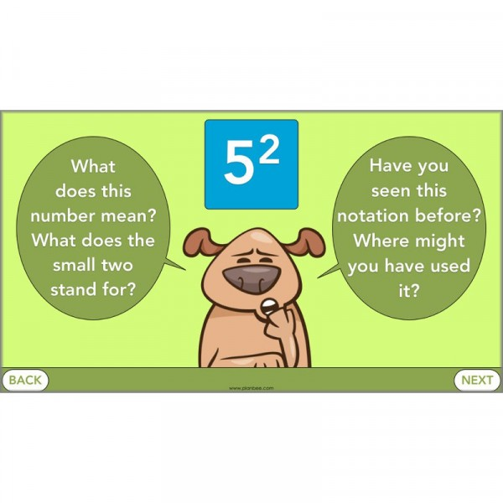
Can you answer the questions below?

Slide 4
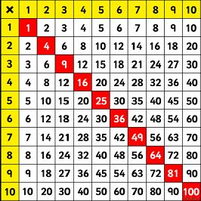
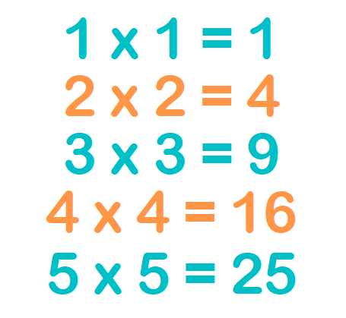
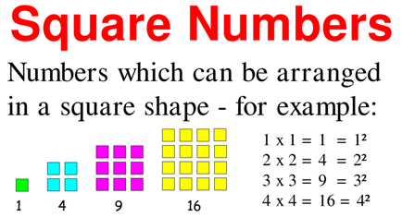
A square number is the answer when a number has been multiplied by itself.

Slide 5
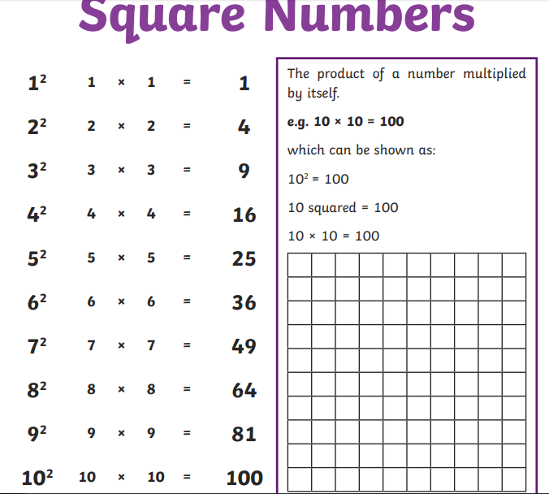

Slide 6
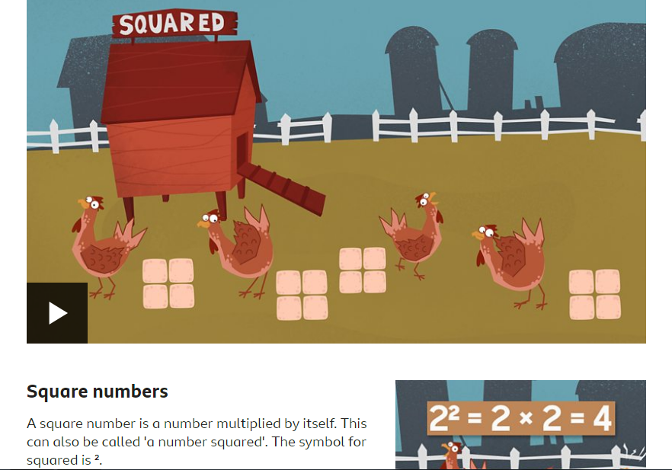
Video link
https://www.bbc.co.uk/bitesize/topics/zyhs7p3/articles/z2ndsrd
Watch the short video.
Concentrate on square numbers but listen to the cube numbers as well.
Read the pieces of information that will support you.
Attempt the challenge at the bottom if you would like to.

Slide 7
Write the square numbers in your book – think carefully. Attempt the cubed numbers if you want to.

Slide 8
Answers

Slide 9
Now try this challenge – you may need to do some working out.

Slide 10
Answers

Slide 11
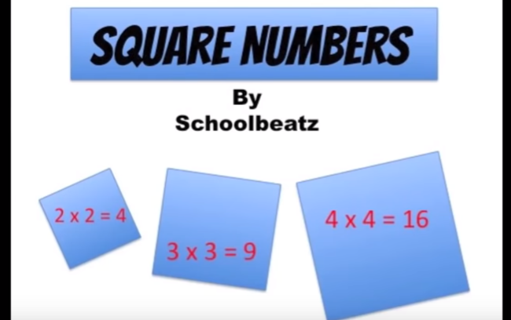
Click the link below for a rap to help you remember the square numbers.
https://www.youtube.com/watch?v=S3xpbDUwuTw

