Slide 1
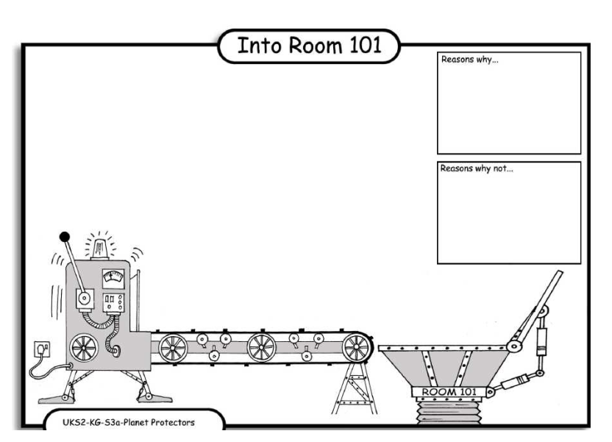
LO: Debating. 4.10.2013 Emma and Leo.
Reasons why:
The tap can wast
Water .
Reasons why:
It can brake and make a flud.
Reasons why:
The tap woodent
Turn off.

