Slide 1
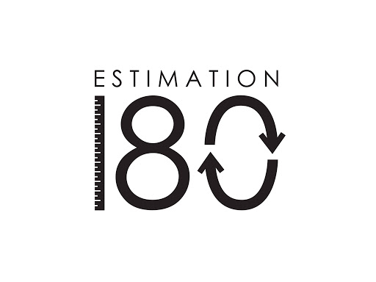
Starters
Today’s estimation.
http://www.estimation180.com/day-39.html
Think carefully about this one. Use your knowledge from yesterday to help you.
You can get 100 either side for this one today. It is more than you’d think!
Use Hit the Button to practise times tables and division skills.
https://www.topmarks.co.uk/maths-games/hit-the-button

Slide 2
Problems of the day

Slide 3
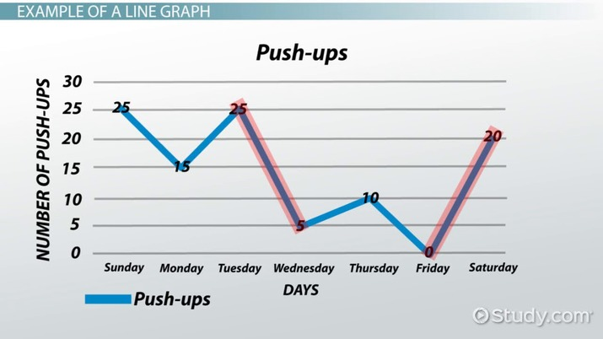
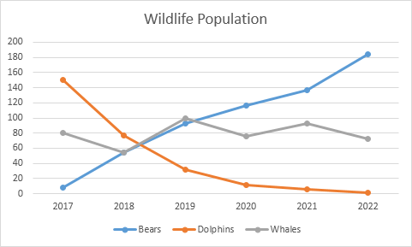
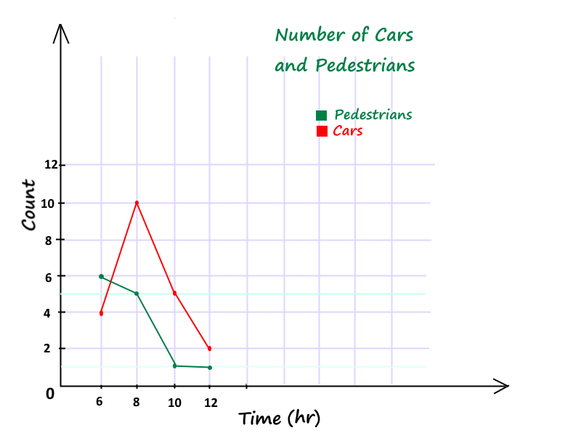
What do the following words mean? There are some pictures of graphs to help you. Write your ideas in your book or in the comment section on the website.
Horizontal
Vertical
X and Y Axis
Extension question:
What do the axis at the bottom have in common in each of these line graphs? This is nearly always the case with all line graphs.

Slide 4
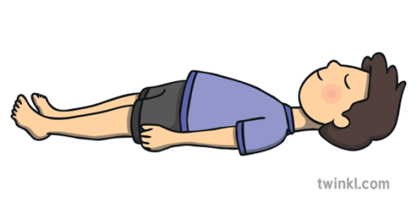
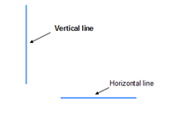
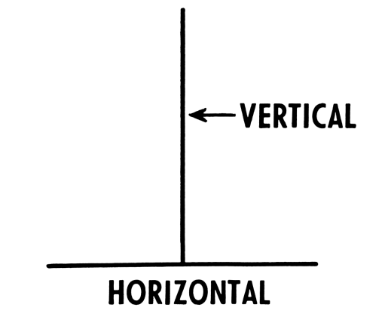
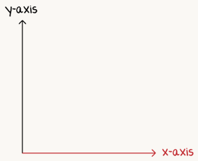
Horizontal is ‘lying down’. It is at a right angle to the vertical. X axis.
Vertical is ‘standing up’. It is at a right angle to the horizontal. Y axis.
X and Y axis are the vertical and horizontal lines for your graph. They go on forever.

Slide 5
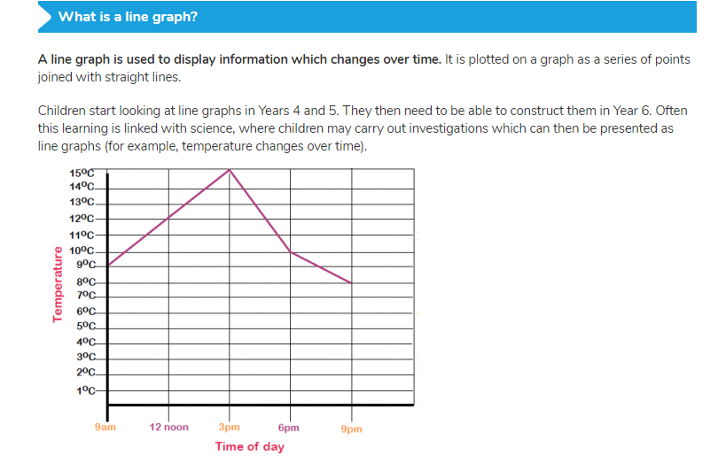

Slide 6
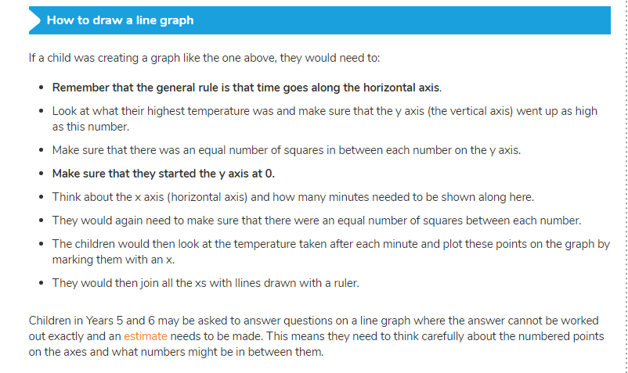
When drawing you own line graphs, if you don’t have squared paper, make sure that you have the same space in between each number. Do what you can.

Slide 7
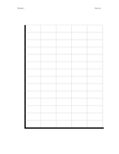
You are now going to draw a line graph. What will you need? That’s right, a pencil, a piece of paper and a ruler. If you don’t have these things, see what you could use instead.
Ok, we are going to follow step by step until we have finished our line graph.
Step one – Draw the X and the Y axis. The
Vertical and horizontal line, joined at a right
angle.
Do not worry about the squares yet but make
sure you have a whole page to do this on as you
may need extra space.

Slide 8
Step 2 – Mark the y axis from 50 up to a 100 in 5’s. Make sure the space between each 5 is the same.
Step 3 – Mark the x axis from 1 to 7, one at a time. Again, make sure the space is the same between each number.
Step 4 – Label the y axis Height (cm) and the x axis Week.
The next slide will show you this if you want to copy. If you’d like to try it first to see how close you were, have a go before going to the next slide.

Slide 9
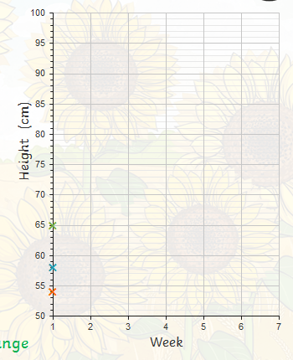
Ignore the three crosses for the moment.

Slide 10
Ok, we are ready. Now for the fun part. We will be plotting one result at a time but first you have to work out which cross is correct and then you can add it to your graph.
Make sure you read the information and the table of results carefully before plotting your next mark.
The following slide will show you where you should have put the previous cross.
Good luck!

Slide 11
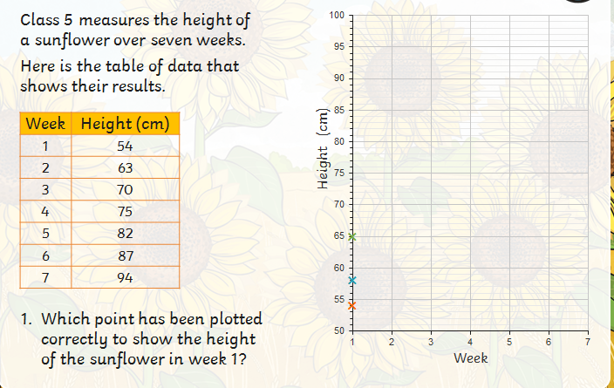

Slide 12
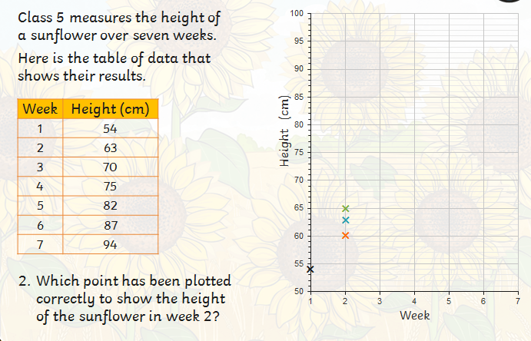

Slide 13
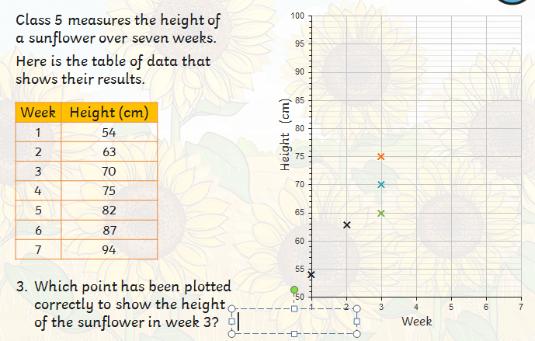

Slide 14
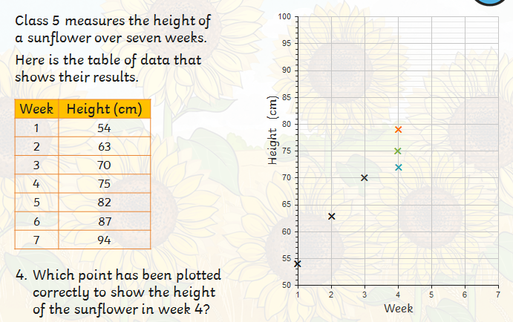

Slide 15
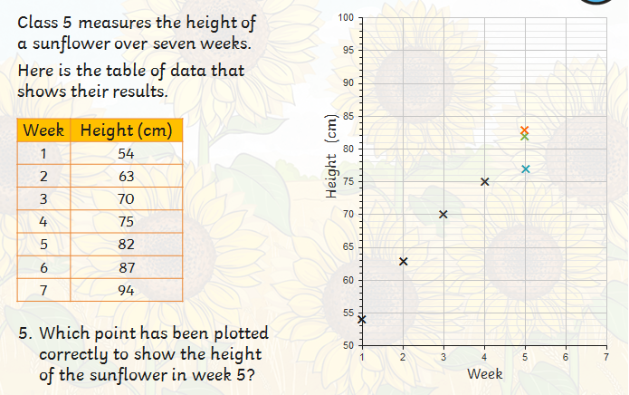

Slide 16
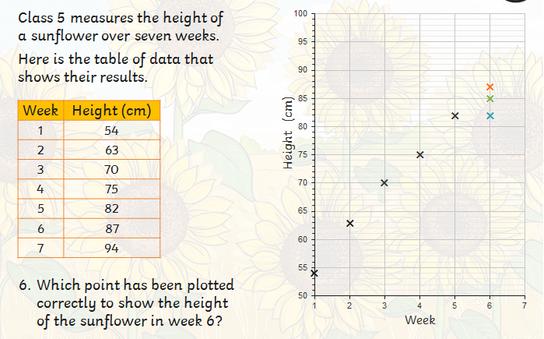

Slide 17
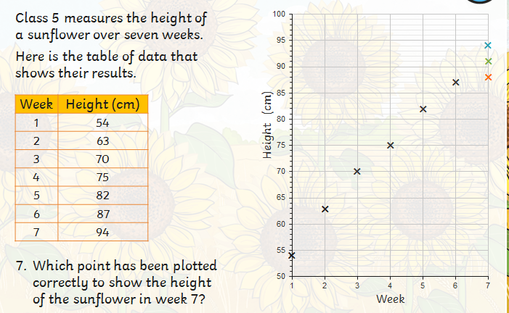

Slide 18
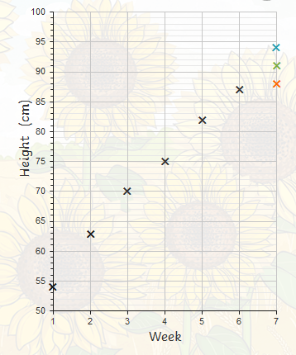
And that’s it. You have your line graph. Well done!
The last correct plot should have been the blue cross. Send me your completed line graphs.
If you feel confident, why not try your own.
Speak to someone about possible ideas
You could do:
Amount of exercise you do per day (in mins)
How much learning you do per day (in hours)
How much reading you do per day.

