Slide 1
Starters
Today’s estimation.
http://www.estimation180.com/day-40.html
You can get 10 either side for this one today.
Use Hit the Button to practise times tables and division skills.
https://www.topmarks.co.uk/maths-games/hit-the-button

Slide 2
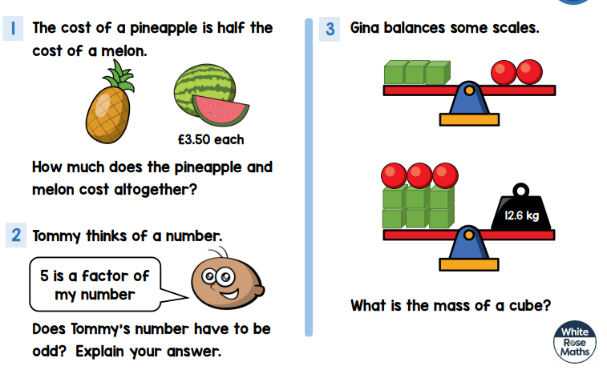
Problems of the day

Slide 3
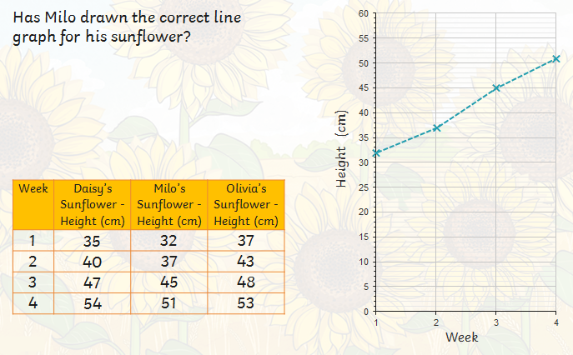
Challenge 1

Slide 4
The answer was YES

Slide 5
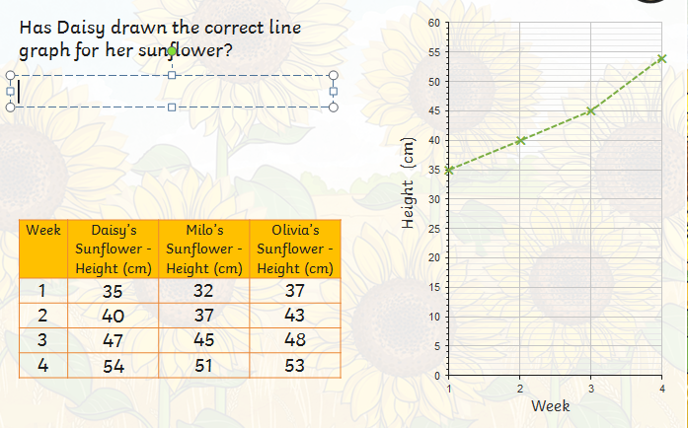
Challenge 2 – look carefully at the CORRECT information.

Slide 6
The answer was NO. The point for week3 has been plotted as 45 and not 47.

Slide 7
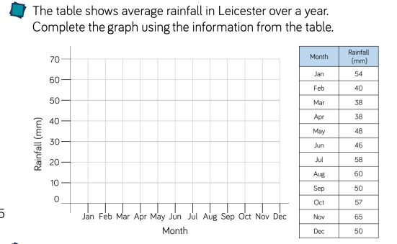
Challenge 3
Discussion point

Slide 8
Challenge 4 – This is a tough one. You may need to discuss this with someone and you may need to try more than once. It’s a great challenge.
Discussion points

Slide 9
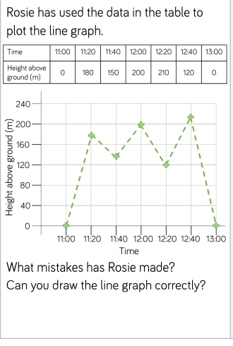
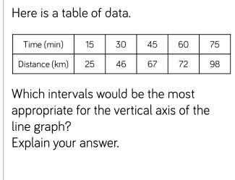
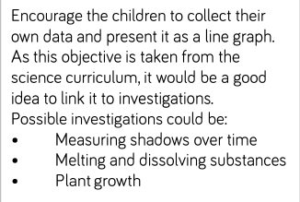
Extended challenges
These are ones that could be done over time. You can also do something that you could measure in a day.

Slide 10
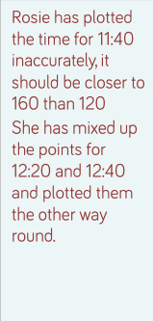
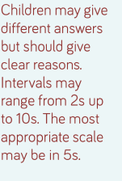
Possible answers

