Slide 1
WELCOME TO YEAR 6
2019/2020

Slide 2
Staff
Head Teacher
Claire Nairne
Deputy Head Teacher
Afua Addai-Diawuo
Phase Leader
Rob Tromans

Slide 3
The Governing Body
The Governing Body’s role is:
To ensure clarity of vision, ethos and strategic direction.
To hold the headteacher to account for the educational performance of the school and its pupils, and the performance management of staff.
To oversee the financial performance of the school and make sure its money is well spent.
Governing Body of 12 (parents/staff/wider community)
Full Governing Body Meetings and Committees
Link Governors
Minutes of full Governing Body meetings are on the school website.
Governor Mark
NLG
The Chair of Governors is Alina Harris and the Vice Chair is Simon Jarvis
Website
You can contact the Governors by email at governors@handsworth.waltham.sch.uk

Slide 4
Friends Of Handsworth
Friends of Handsworth is comprised of parents and carers who voluntarily organise events and fund-raising activities for the school. Our purpose is to raise money to support projects that benefit the children of Handsworth Primary.
Some of the fund-raising events we run include Quiz Nights, the Christmas Market, a Pamper Evening and of course the School Fete.
Contact us at foh@handsworthprimary.org.uk if you would like to offer your help with a FOH activity or even take the lead on organising a fundraising event!

Slide 5
Safeguarding
Handsworth Primary School ensures that children learn in a safe, caring and enriching environment.
The school complies with current guidance for Keeping Children Safe in Education, issued by the DFE in September 2018, and staff receive current safeguarding training annually.
The school has a statutory responsibility to share concerns it might have about a child in need of protection with other agencies and in particular the police, Health and Social Care and Children’s Services.
Handsworth Primary School’s Safeguarding Team
Designated Safeguarding Lead | Mrs C Nairne, Head Teacher
Deputy Designated Safeguarding Lead | Ms A Addai, Deputy Head Teacher
Deputy Designated Safeguarding Lead | Ms A Struthers, Inclusion Lead
Safeguarding Link Governor | Alina Harris
Any concerns about pupils should be reported immediately to one of these members of staff.
Anyone can make a referral to the Multi-Agency Safeguarding Hub (MASH) if a child is at risk of significant harm. Waltham Forest MASH can be contacted on 020 8496 2310 or via email at MASHrequests@walthamforest.gov.uk The police can be contacted in an emergency on 999.

Slide 6
Staff
Teachers
Mrs Glanvill
Mr Mussell
LSAs
Mrs McDermott
Mrs Gobey

Slide 7
Yearly Curriculum Overview
Autumn Term
This term, we will be focusing on the Ancient Greeks across the curriculum. This includes our Ancient Greek Day at the end of October, where everyone dresses up! We will also study South America and begin our year of performances by writing and sharing our Slam Poetry.
Spring Term
As well as preparation for the SATS, we will be welcoming Anthony Glenn once again for Shaking up Shakespeare and creating adverts in Computing.
Summer Term
So much happens in the Summer in Year 6; we will be going on our residential to Stubbers, completing SATS, First Aid and Refugee Awareness training, transition meetings, the Year 6 leavers’ play and graduation!

Slide 8
This Term:

Slide 9
Daily Routines
Beginning of the day
The gates open at 8.35am and the children can begin lining up outside their classrooms from 8:45am.
Please note that children are not allowed on the play equipment or to play ball games before or after school.
The gates close at 8.50am. If your child arrives after this time you will need to sign them in at the school office.

Slide 10
Creative Curriculum
During the morning we complete our English and Maths lessons. Every day children have the opportunity to change their reading books.
Children complete English activities in their class groups. These activities include Reading Comprehension activities, Writing, Speaking and Listening, Drama and a variety of other activities.
Children will also be taught Maths in their class groups. These lessons will be differentiated to ensure the appropriate amount of challenge and support.

Slide 11
End of the day
The gates are opened just before the end of the day to allow parents and carers onto the playground. Staff will dismiss the children onto the playground from the classroom to meet with whoever is picking them up at 3.30pm.
If you need to talk to a member of staff at the end of the day, please wait until most of the children have been dismissed. Thank you.
Please write a note or ring the school before 2.30pm to inform the teacher if someone different will be picking up your child.

Slide 12
Homework and Spellings
Homework is important as it helps your child to practise the skills they have learnt in school. Encouraging and supporting them to complete it on time will ensure they understand everything that is being taught in lessons. We will set Maths, Comprehension and Spellings every Friday. This is a key part of your child’s learning and we expect it to be completed and handed in by the following Thursday. Spelling tests will be on Thursdays/Fridays. If your child is not sure about the homework, they can attend Homework Club on Mondays at 12.15pm or Tuesdays at 3.30pm.

Slide 13
Homework and Spellings
Maths Maths homework is set weekly. Log in to the My Maths website: www.mymaths.co.uk and use the Handsworth login to enter the Handsworth area then your own personal login to access your own work area. Comprehension Comprehension is also set weekly through my.risingstars-uk.com. You have your own personal logins for this site. Please note that this site does not work with the Google Chrome browser. Spellings A list of spellings for the whole Autumn term is on the Homework page of our class area. Children will receive a Spelling Book and need to return completed spellings to school each Thursday. They will be tested each week on the words for that week plus five words from the previous week.

Slide 14
Behaviour and Safety
In Year 6 we expect
Exceptional behaviour
Leaders of the school
Role models
Demonstrating expected behaviour around the school

Slide 15
End the day here
and get a
piece of the balloon
If the class completes the balloon by the end of term, you will receive a whole class end-of-term treat.
Start the day here
If you reach this point you will receive a consequence
This is 5 minutes off Golden Time.
It could also mean being off the playground at lunch time or break, or being sent to Mrs Nairne or Miss Addai.
If you reach this point this is a final warning
This means that you need to look at your mistake, value it as a learning experience and change your behavior to move back up to In the zone.
End the day here
and you receive a golden leaf
You will also get a piece of the balloon and earn time.
End the day here and earn time
This will count towards your weekly Golden Time

Slide 16
SATs
At the end of Key Stage 2, all children are assessed in Reading, Writing, Grammar, Spelling and Punctuation and Maths using a combination of tests and teacher assessment. Their results will be reported to you in the End of Year Report.
Further information about SATs will be given later this year.
Please do not practise any SATs papers from 2015 onwards as we will use these for assessment purposes throughout the year.

Slide 17
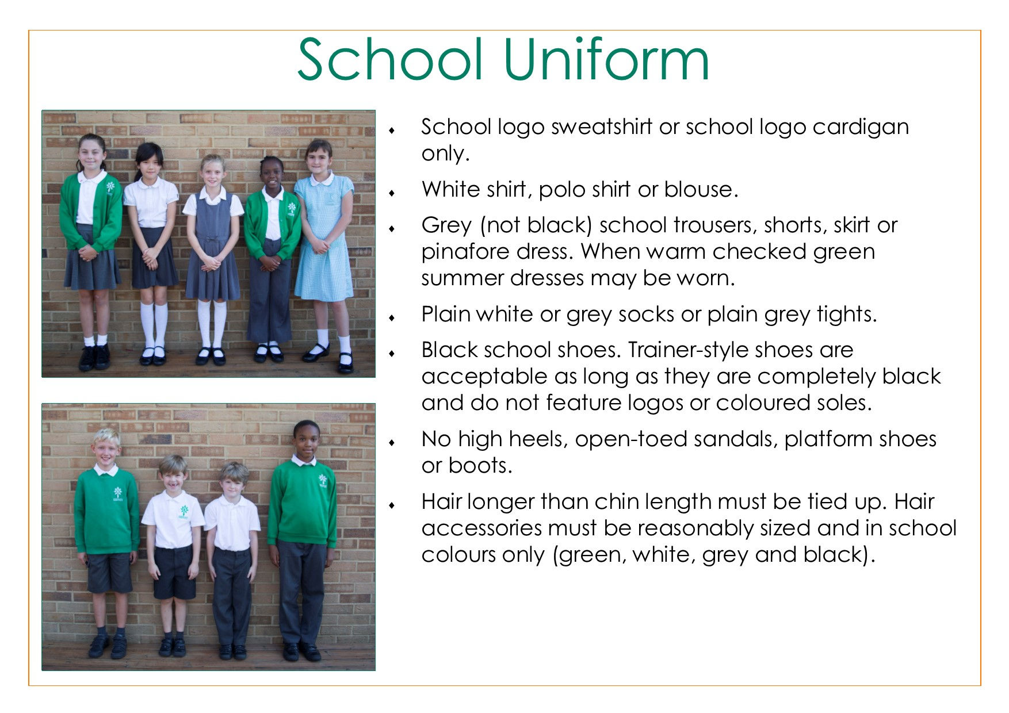
School Uniform Reminder
*Items marked with a star are available for purchase from the School Office at the end of the day.
Please mark all your child’s clothing clearly with his/her name.
A school book bag is required for all children and is on sale in the school office.
Footwear - We ask that special attention be given to footwear at all times. Wearing plimsolls and trainers to and from school is not acceptable. Those items are only for games and outdoor play. Pupils change for the start of lessons. Girls are not allowed to wear high or thin heels of any kind.
P.E. and Games Kit – Girls and Boys | Other Equipment / Optional Items
Bottle green shorts* White polo shirt* Black plimsoles for indoor P.E. White or black trainers for outdoor P.E. Black tracksuit for Games/P.E. | Bag for swimming/P.E. kit for hanging cloakroom Apron/old shirt for art/craft activities (provided in Foundation Stage) School bookbag* Water bottle* School Cap / sun hat*

Slide 18
PE kit reminder
Plain white T-Shirt
Plain black shorts
Plain black jogging bottoms
Plain black plimsolls/ trainers
All PE Kit is available on the school shop which you can access via the school website.

Slide 19
How you can help your child at home.
Reading
Supporting Reading at Home
Try to read for at least 5 to 10 minutes a day and once over the weekend. Encourage it as a pleasurable experience.
Find some time to talk about the book as well as reading it.
Ask your children questions while they are reading so they can explain their understanding.
Encourage your child to retell the story you have just shared. This will give you an idea of how much they have understood.
What happened in the story? Does this remind them of anything in their lives or anything they have read before?
Did they think the book was funny? Did they spot any interesting words and phrases? Did they enjoy the book?
Let them read their favourites. It's good practice to read the same books over and over again.

Slide 20
How you can help your child at home.
Maths
As with reading, try to make maths as much fun as possible - games, puzzles and jigsaws are a great way to start. It's also important to show how we use maths skills in our everyday lives and to involve your child in this.
Identifying problems and solving them can also help your child develop maths skills. If you see him or her puzzling over something, talk about the problem and try to work out the solution together.
Try to find ways to enjoy the subject with your child.
Tips for helping your child to enjoy Maths:
Take your child shopping and make a game of adding up what you put in your basket.
Let your child handle money and work out how much things cost.
Ask them to convert grams to kg.
Remember to practise the basics with them – number bonds to 100, times tables, rounding, place value, etc.

Slide 21
Important Dates

Slide 22
Thank you for coming.

