Slide 1
Starters
Today’s estimation.
http://www.estimation180.com/day-33.html
Use Hit the Button to practise times tables and division skills.
https://www.topmarks.co.uk/maths-games/hit-the-button

Slide 2
Problems of the day

Slide 3
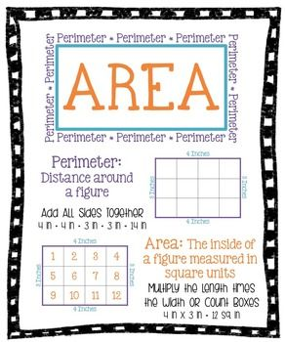
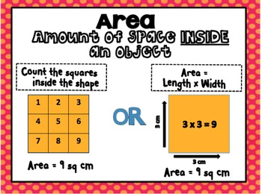
What is area?

Slide 4
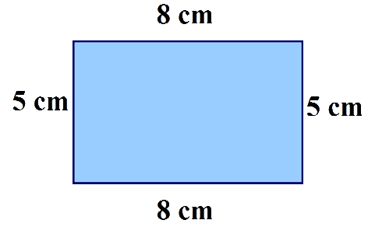
Can you work out the perimeter and the area of the shape below?

Slide 5
Answers
Perimeter – 5 + 5 + 8 + 8 = 26cm
Area = 5 x 8 = 40cm²

Slide 6
Try this link for a video on perimeter and area.
https://www.youtube.com/watch?v=rSVMrPu0__U

Slide 7
Challenges

Slide 8
Answers
Ignore the numbers 2 and 4 if you did these.

Slide 9
Extended learning

