Slide 1
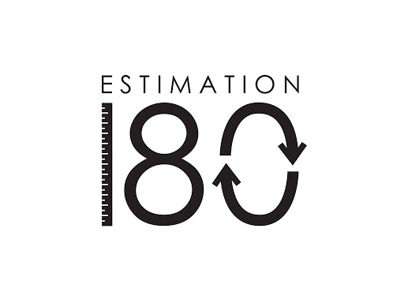
Starters
Today’s estimation.
https://estimation180.com/day-124/
Be observant with this one. Let me know how you got on and explain the answer once you find out the correct weight. You can get within 10g again.
Use Hit the Button to practise times tables and division skills.
https://www.topmarks.co.uk/maths-games/hit-the-button

Slide 2
Problems of the day

Slide 3
Answers to Problems of the Day

Slide 4
Today we will be looking at Calculating angles on a straight line. You will find the video in SUMMER TERM –Week 10 (w/c 29th June). It is lesson 3.
https://whiterosemaths.com/homelearning/year-5/

