Slide 1
Starters
Today’s estimation.
http://www.estimation180.com/day-110.html
Mr Stadel is 6 foot 4 inches (6’4). How tall is the bus in feet and inches. You can get within one foot.
Tread carefully! Hahahahaha!
Use Hit the Button to practise times tables and division skills.
https://www.topmarks.co.uk/maths-games/hit-the-button

Slide 2
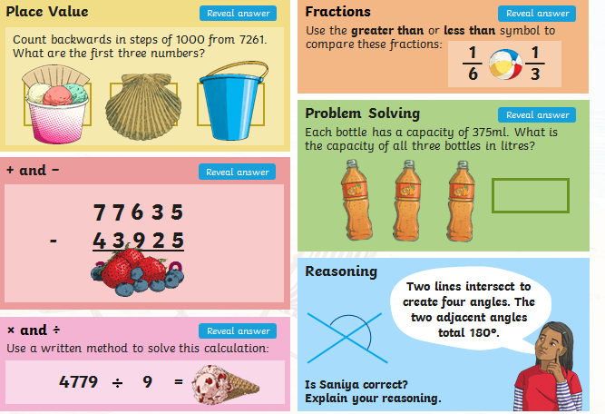
Problems of the day

Slide 3
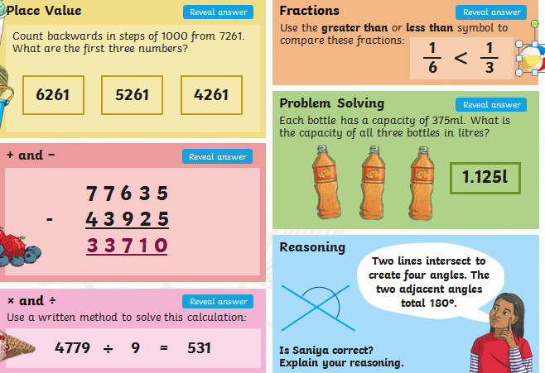
Answers to Problems of the Day

Slide 4
FRIDAY MATHS CHALLENGE It is Friday and so the Friday Maths Challenge. 10 different challenges for you to attempt. The questions get more difficult as you continue. Questions 7-10 are extension questions, based on Year 7 and 8 level so decide whether you want to try these or not. You will be able to do some of these but you will have to motivate yourself to spend more time and effort in finding the answers. Give some a go. We know you can do it! Answer as many as you can and then you will find all the answers on the last slide. Think carefully about what Maths skills can help you answer each question. Good luck.

Slide 5
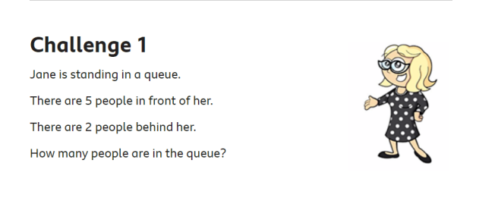

Slide 6
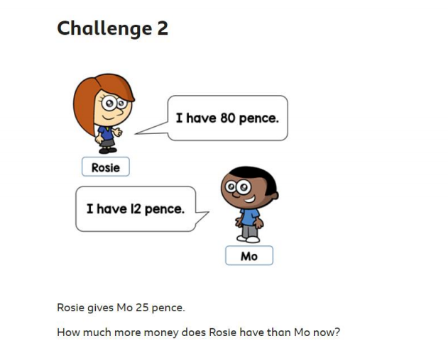

Slide 7
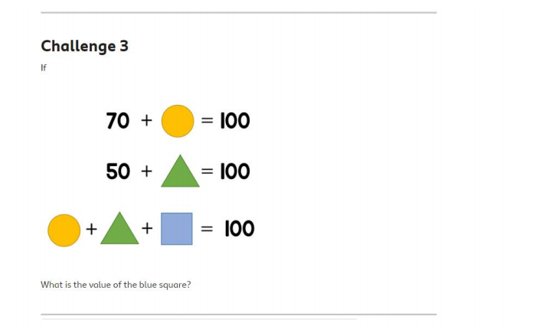

Slide 8
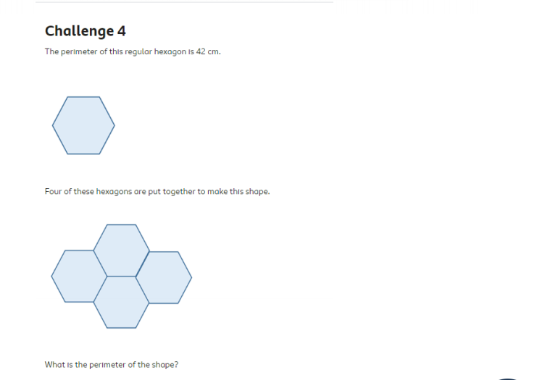

Slide 9
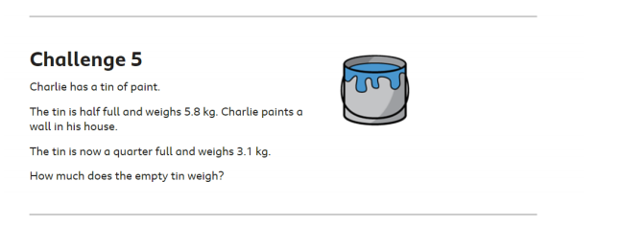

Slide 10
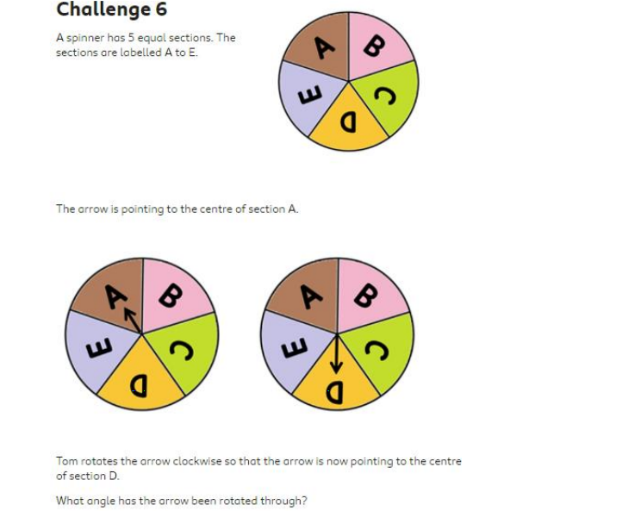

Slide 12
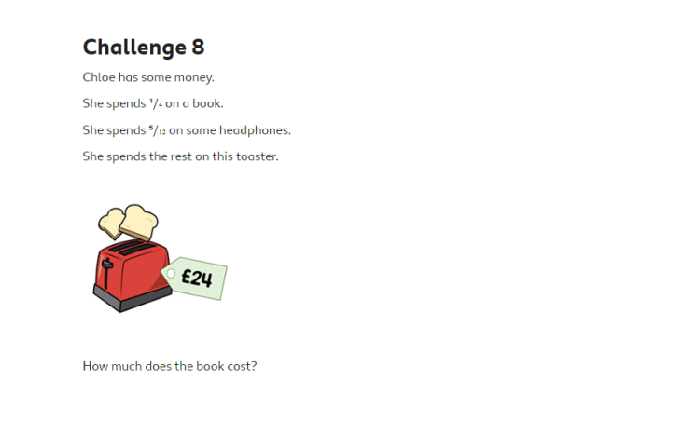

Slide 14
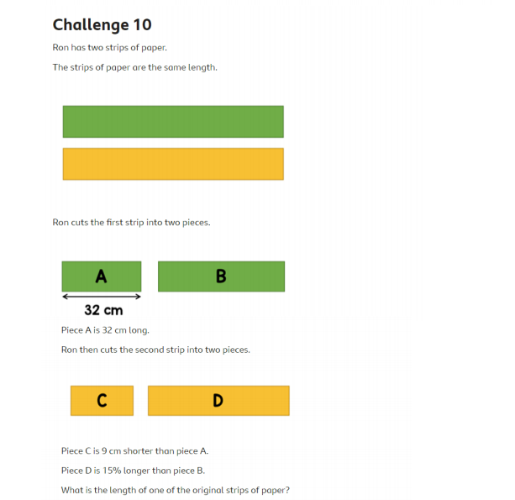

Slide 15
