Slide 1
Starters
Today’s estimation.
http://www.estimation180.com/day-60.html
Final one on capacity. Think about the shape of this vase. You can get 50ml either side.
Use Hit the Button to practise times tables and division skills.
https://www.topmarks.co.uk/maths-games/hit-the-button

Slide 2
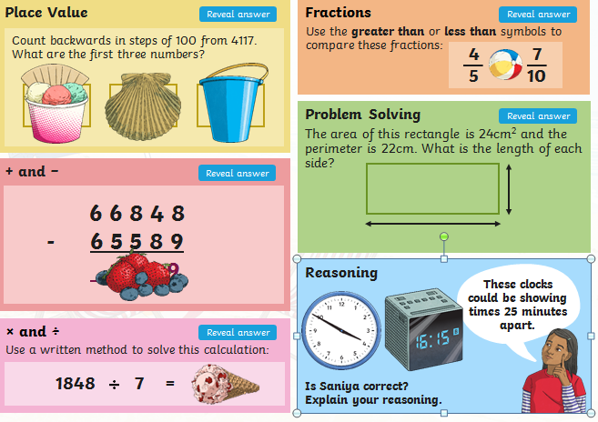
Problems of the day

Slide 3
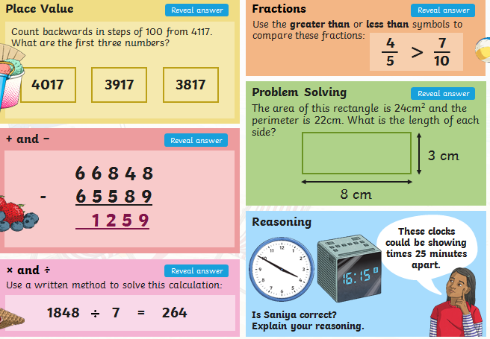
Answers to Problems of the Day

Slide 4
Can you solve the mystery??
As it is the last day of Half Term I thought it would be fun to attempt to solve a mystery.
Usually we do these in groups at school so if you wanted to include family members and solve the clues together that is ok.
However you might want the ‘Ultimate challenge’ and attempt to solve it all by yourself.
You may find some clues harder than others so do the ones you feel more confident with first. Remember to cross off the individuals as you go along. Solving the clues help you to do this.
Then you can go back and attempt the ones you were not sure on.
Remember, you do not have to solve every clue to guess who the culprit was but the more you solve the easier it will be.
Will you solve the mystery……

Slide 5
The mystery you are going to try and solve is…

Slide 6
……………………………………………………………………..

Slide 7
…………………………………………………………………….

Slide 8
Are you ready?

Slide 9
It’s a bit late now as Easter has passed but…..

Slide 10
Good luck…………………………………………………

Slide 11
Are you sure you are ready???

Slide 12
Ok, here it is…………

Slide 13
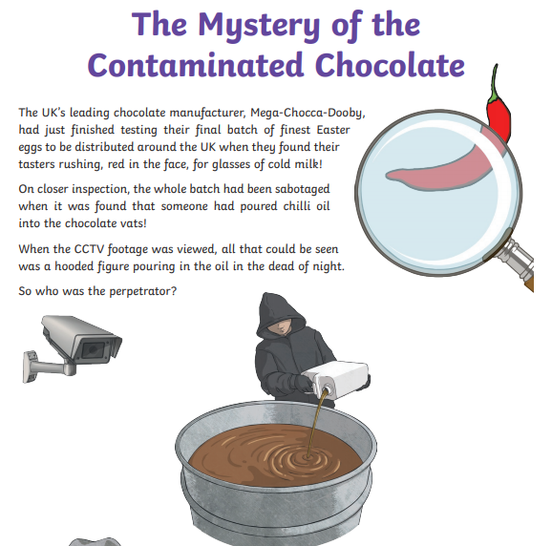

Slide 14
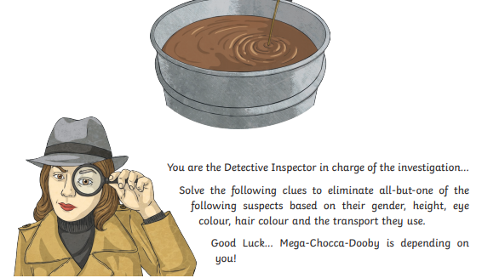

Slide 15
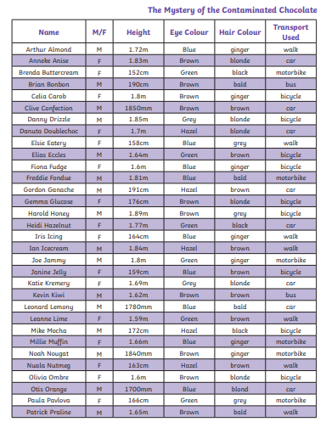

Slide 16
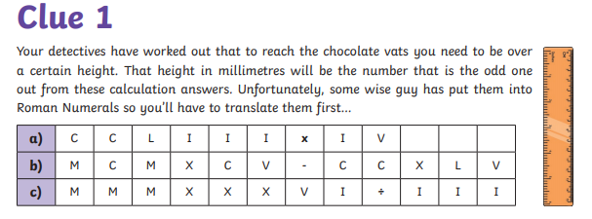

Slide 17
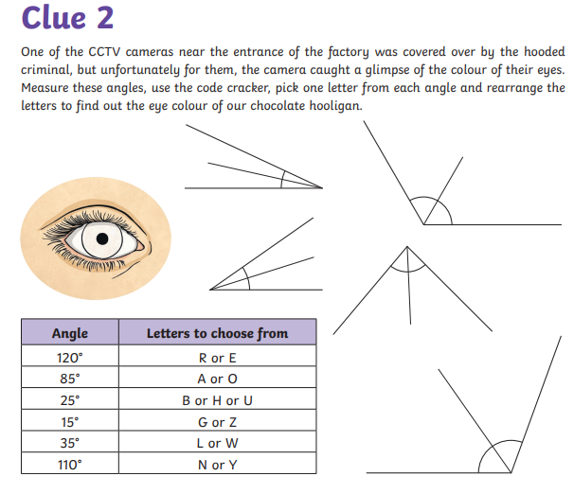
If you do not have a protractor you could make sensible predictions with your knowledge of angles.
Be careful and do not rush this one.

Slide 18
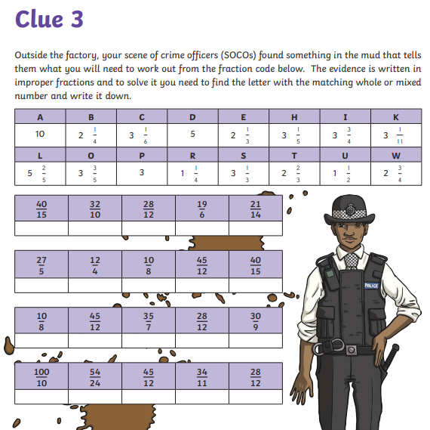

Slide 19
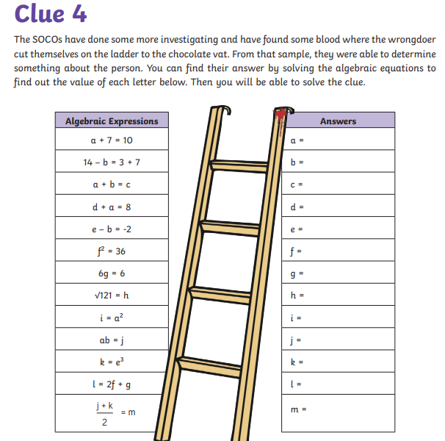

Slide 20
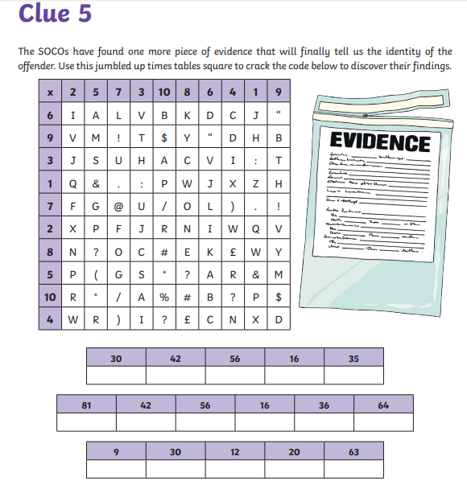

Slide 21
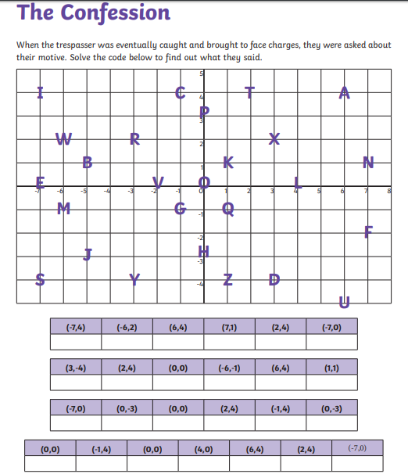
Who do you think it was? The answer is coming up. Here is their confession if you would like an extension activity. They tell you why they did it.

Slide 22
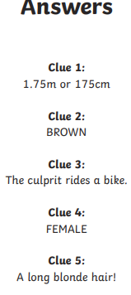

Slide 23
Do you know who it is yet?

Slide 24
Yes? No? Not sure?

Slide 25
Well here is the answer

Slide 26
Actually I’ll reveal it after Half Term…

Slide 27
Only joking, here it comes…

Slide 28
