Slide 1
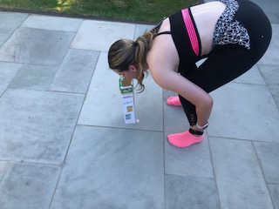
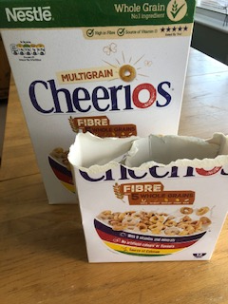
Primary at home challenges
KS2
CEREAL BOX CHALLENGE
Equipment needed: An empty cereal box.
1. Place the cereal box on the floor.
2. Pick up the cereal box ONLY using your mouth. Only your feet can remain on the floor.
3. If successful, tear 5cms from the top of the box and play again.
4. REPEAT until you can no longer pick up the box.
How low can you go?
Hold onto your legs to aid balance
Can you challenge a family member?

