Slide 1
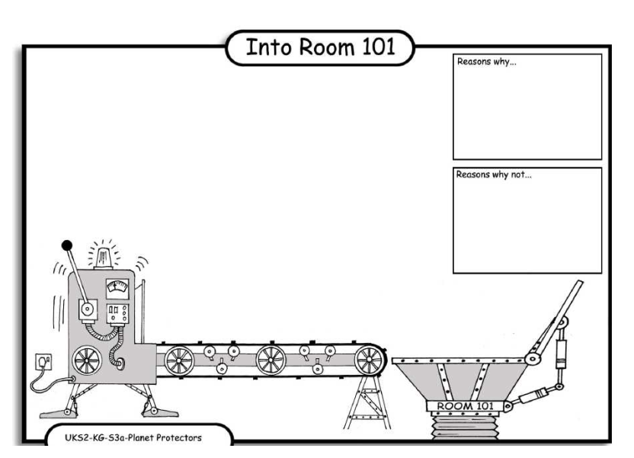
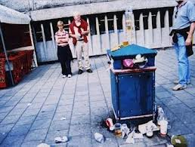
LO: Debating. 4.10.2013 Edmond and Alistair
Reasons why:
It is bad for the world because people mite
Slip owver and brace
Something.
Reasons why:
Too much rubbish in the street mite hurt the world because animals will get hurt.
Reasons why:
A bin is bad because too mutch rubbish will be a mess and corses rats.
Reasons why:
Litere is bad for the world because it smelse descusting and people mite fanet.

