Slide 1
Starters
Today’s estimation.
http://www.estimation180.com/day-54.html
Think about how much the can held and compare. I will allow 50ml either side.
Use Hit the Button to practise times tables and division skills.
https://www.topmarks.co.uk/maths-games/hit-the-button

Slide 2
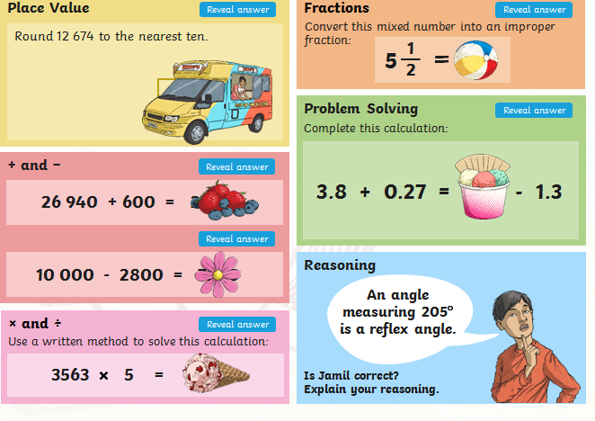
Problems of the day

Slide 3
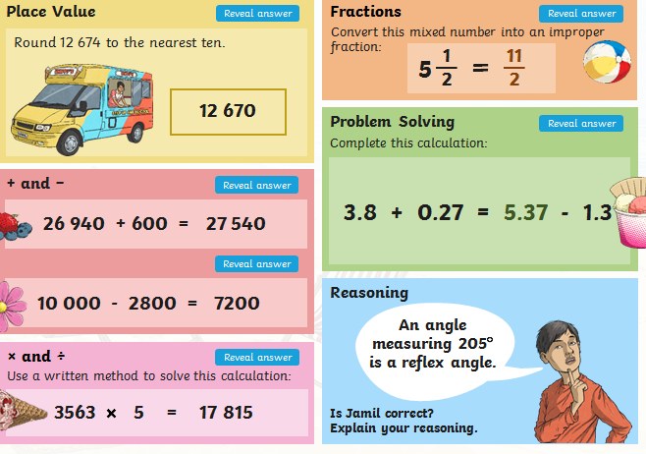
Answers to Problems of the Day

Slide 4
Open this video for an introduction to today’s lesson. Week 2 (not summer!) - Lesson 3 – Understand percentages
https://whiterosemaths.com/homelearning/year-5/

Slide 5
Here are a few links to give you extra support if you feel you would like it. You do not need to read and watch them all. Maybe you will come back to one or two of them after the lesson if you think you need to.
https://www.youtube.com/watch?v=Zx9_ja_2H38
https://www.theschoolrun.com/what-is-a-percentage
https://www.youtube.com/watch?v=WNrmnQ3TjFY

Slide 6
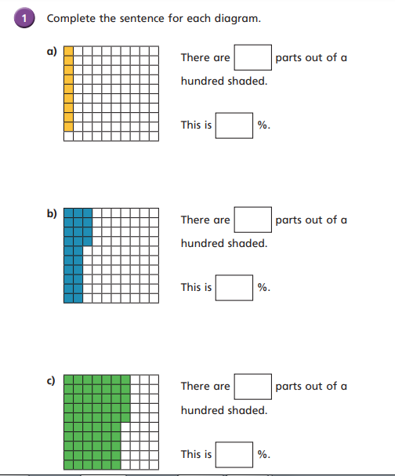

Slide 7
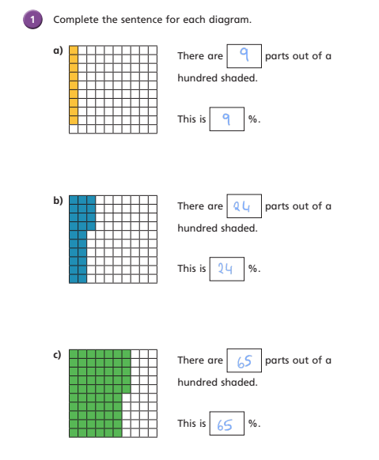

Slide 8
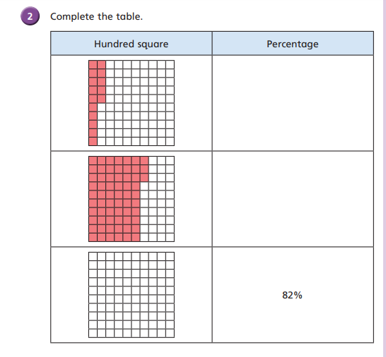

Slide 9
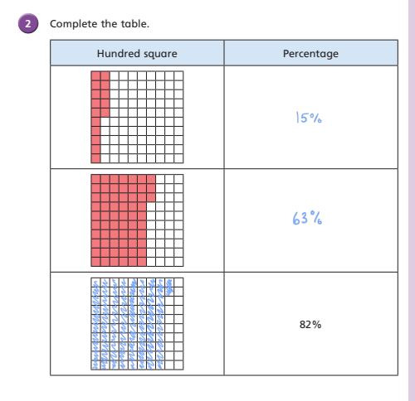

Slide 10
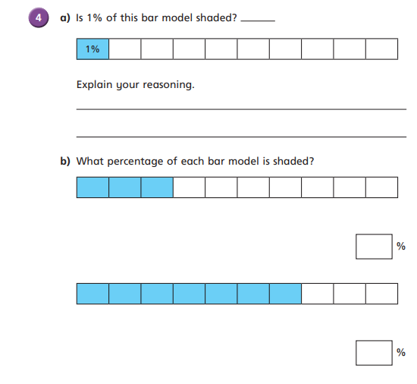

Slide 11
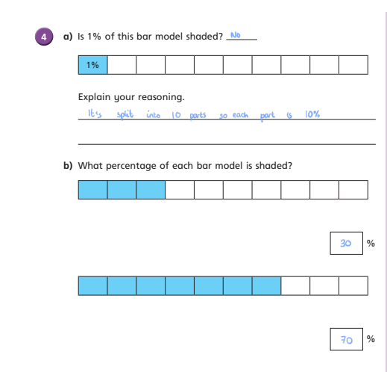

Slide 12
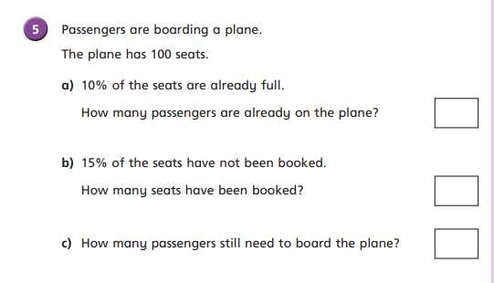

Slide 13
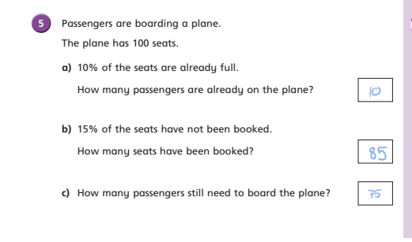

Slide 14
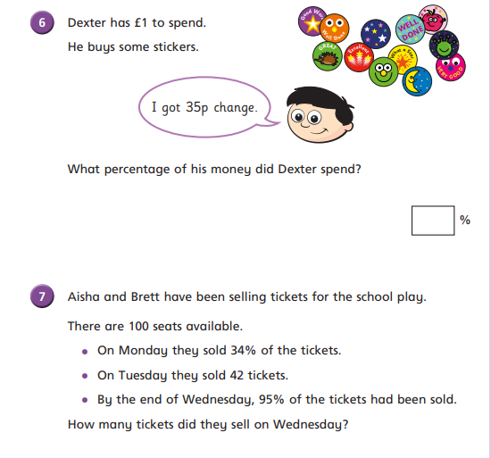

Slide 15
