Slide 1
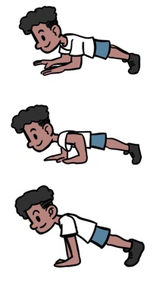
Primary at home challenges
KS2
Fitness challenge – You will need some floor space and a timer.
Do each exercise for 40 seconds and see how many you can complete.
1. Jumping Jacks 2. Squat thrusts
3. Plank get ups 4. High Knees
5. Mountain climbers
Try again tomorrow and see if you can beat your score!
GOOD LUCK!
Can you challenge a family member?

