Slide 1
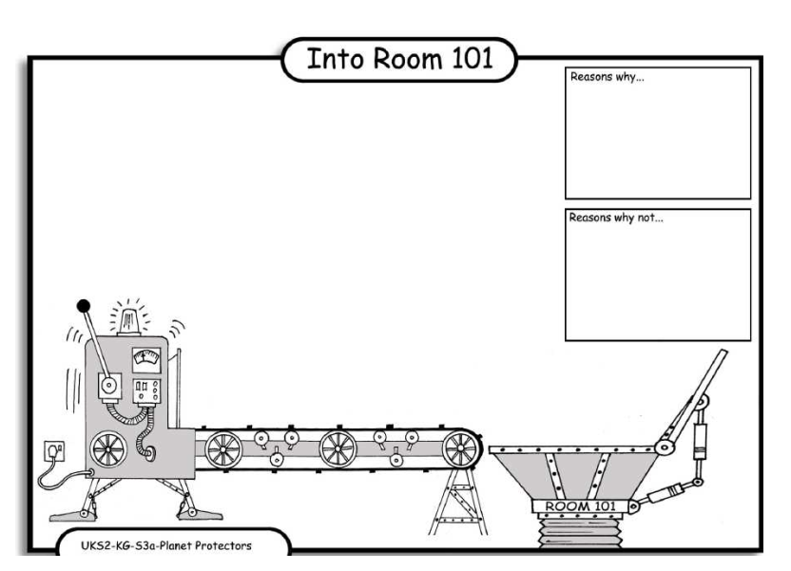
LO: Debating. 4.10.2013 James and Bethany
Reasons why:
They use a lot of fuel.
Reason why:
If you go under a arplan you got hept.
Reasons why:
Arplan are nose
They make a lot of noise.
Reasons why:
The smoke from the aeroplan pollutes the air.

