Slide 1
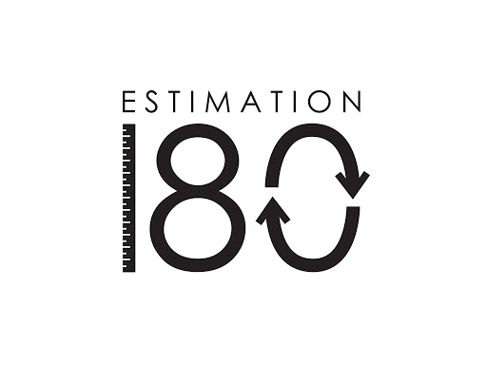
Starters
Today’s estimation.
http://www.estimation180.com/day-41.html
You can get 20 either side if you guessed in feet and 5 metres either side if you guessed in metres.
Metres answer will be on the next slide.
Use Hit the Button to practise times tables and division skills.
https://www.topmarks.co.uk/maths-games/hit-the-button

Slide 2
Starters
Today’s estimation.
http://www.estimation180.com/day-41.html
You can get 20 either side if you guessed in feet and 5 metres either side if you guessed in metres.
Metres answer is 33 metres so if you guessed from 28-28 metres you get the point.
Use Hit the Button to practise times tables and division skills.
https://www.topmarks.co.uk/maths-games/hit-the-button

Slide 3
Problems of the day

Slide 4
Challenge 1

Slide 5
Challenge 2

Slide 6
Now try your own investigation – you will record your own results and draw your own line graph.
When measuring your pulse rate after an exercise:
Count for 15 seconds and then multiply by 4.
Also make sure you have found your pulse before counting. Feel your heart beat if you can’t find it.
Take your pulse rate. Count your pulse rate for 60 seconds and record your answer.
Now run on the spot for 60 seconds and then count your pulse rate again. Record your answer.
Next, do a minute of star jumps and measure your pulse rate. Record your answer.
Have a minute rest and then measure your pulse rate again. Record your answer.
Now, choose one or two exercises that are hard for you and do each for 30 seconds. Then measure your pulse rate and record.
Finally, rest for 5 minutes and measure your pulse rate one last time. Record the answer.
On the next slide I have shown you my own results. If you are not sure you can have a look at these. Alternatively you can use my results to draw the line graph.

Slide 7
Here are my results.
Activity | Time | Pulse rate
Counting resting pulse rate | 1 min | 60
Run on the spot (1 min) | 2min | 96
Star jumps (1 min) | 3 min | 116
Rest (1 min) | 4 min | 60
Press ups and burpees (30 secs each) | 5 min | 148
Rest for 5 min | 10 min | 76
If you haven’t been able to do your own results or are still not sure you can use my results and draw a line graph. My line graph is on the next slide.

Slide 8
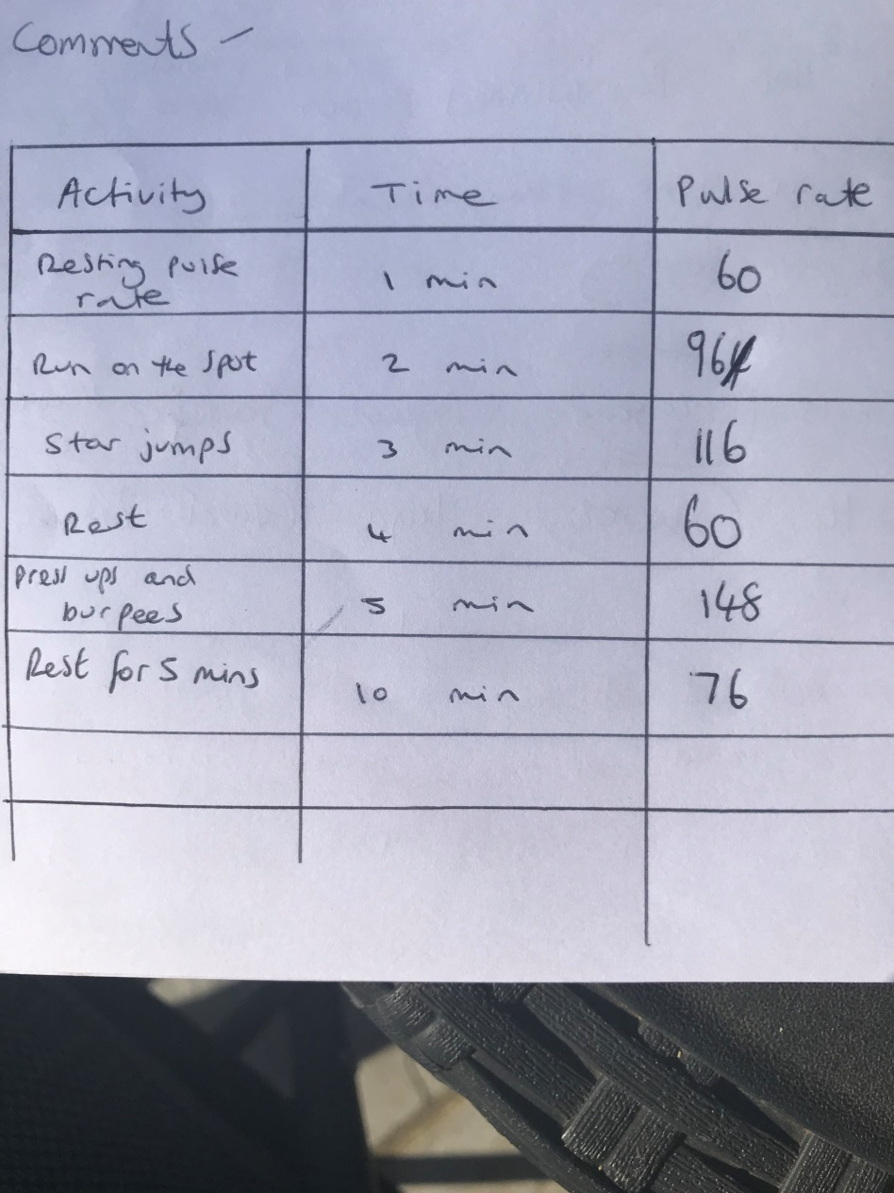
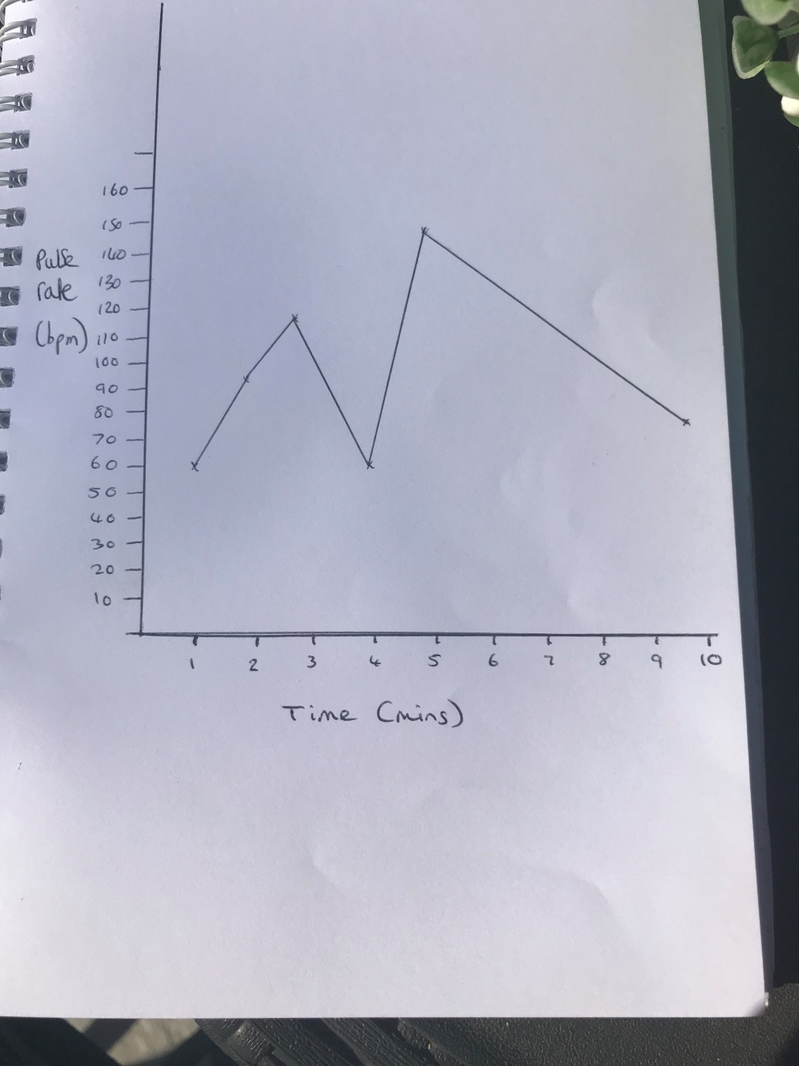
My line graph

Slide 9
Once you have done your line graph, attempt to explain the results. You can read my explanation of my results to help you if you want.
My pulse rate made a steady rise during the first two exercises.
It then quickly returned to a resting rate after being able to rest for a minute.
There was then a steep rise to my highest pulse rate of the investigation.
I think this is because the two activities I chose are very difficult for me and my heart had to work very hard.
My pulse rate then made a steady decrease back towards my resting pulse rate.
Interestingly, it didn’t return to resting heart rate after 5 minutes. I think this is because I tried hard with the two exercises and knew it was the end so put in even more effort.

