Slide 1
Water aid
Sophie & Caitlin

Slide 2
Uganda
• 65,000 people with safe water
• 102,000 people with improved sanitation.
To date, we have helped 920,000 people access safe water, and improved sanitation and hygiene in Uganda.

Slide 3
What water aid do
Water Aid is an international non-profit organisation that was first set up as a response to the UN International Drinking Water & Sanitation decade (1981–1990). Water Aid works in 27 countries worldwide, transforming millions of lives every year with clean water, safe toilets and hygiene education.
Water Aid works with local partners to help communities make toilets and taps accessible to all, and uses its experience and research to influence decision-makers to do more to provide these vital services.

Slide 4
How to save water
you how to save water and we would like you to know to! We have lots of ways to show
When you have a bath share it with your siblings.
Don’t leave the tap running.
When you get a drink of water try to drink it all or give it to someone else.
We you go to the toilet and someone wants to go after you don’t flush it until the other person has finished.

Slide 5
How to support Water aid?
Just donate £2 a month and it could stop children from drinking dirty water.
At the minute water aid are making special pumps just for people that are in need for water and are so they are going to send as many as they can over the world.

Slide 6
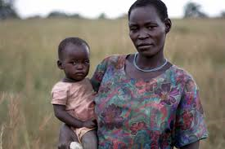
Facts about Uganda
Over 22 million people don't have access to adequate sanitation in Uganda, almost two thirds of the population.
Over half the population in Uganda lacks a safe place to go to the toilet. This is almost a quarter of the population.

Slide 7
Thank you for listening

