Slide 1
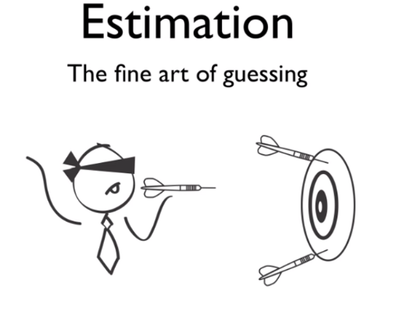
Estimation 180
If you are able to, ask some family members to join in with you and create your own daily league. I will send the link to the next challenge each day, as a starter, to get us warmed up.
Remember, it is so much more fun to play along and not look at the answer before you estimate.
You could also make up your own challenges with objects around the house. Ask an adult to help you with your challenges.

Slide 2
Starters
Today’s estimation
http://www.estimation180.com/day-25.html
Use Hit the Button to practise times tables and division skills.
https://www.topmarks.co.uk/maths-games/hit-the-button

Slide 3
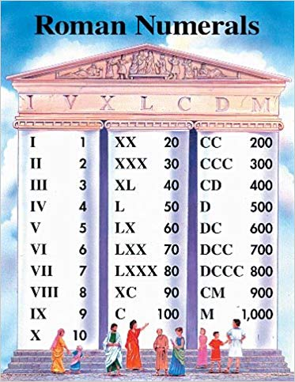
Activities
Watch the video below from 8:35 to 14:20.
https://www.youtube.com/watch?v=p8IE1279KyE
Write down the Roman Numerals from 1-30 and have a look at the picture opposite for bigger numbers.
Then try the questions on the next page. Just do the ones that you can in your exercise book.

Slide 5
Extended learning
If you’d like some more challenges try this website. It has beginner, intermediate and advanced levels. Have a go.
https://www.factmonster.com/math/roman
If you want more help, use this website. It breaks a number apart for you to see more clearly.
https://www.mathsisfun.com/roman-numerals.html

